Slide 1

St Paul's C of E Primary School
Maths Parents Meeting

Slide 2
The 2014 National Curriculum for Maths aims to ensure that all children:
Become fluent in the fundamentals of Mathematics
Are able to reason mathematically
Can solve problems by applying their Mathematics

Slide 3
At St Paul’s we also aim to ensure that all children:
Enjoy maths
Experience success
Become confident in their ability to use and apply their mathematical skills and knowledge in a range of contexts
Recognise the importance and relevance of Maths in the wider world
Develop mathematical resilience

Slide 4
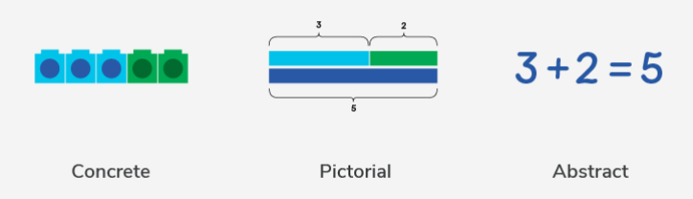
Children learn new concepts through the concrete, pictorial, abstract approach.
Reinforcement is achieved by going back and forth between these representations.

Slide 5
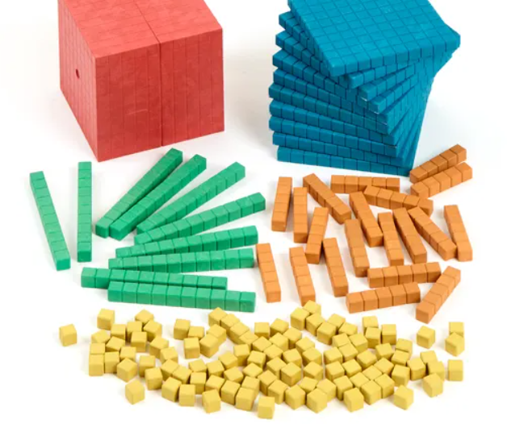
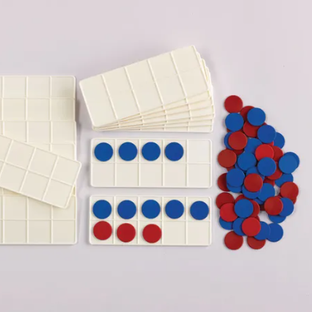
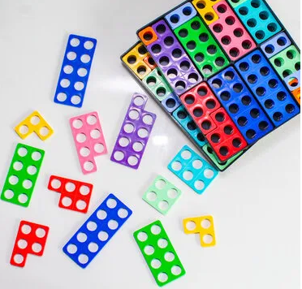
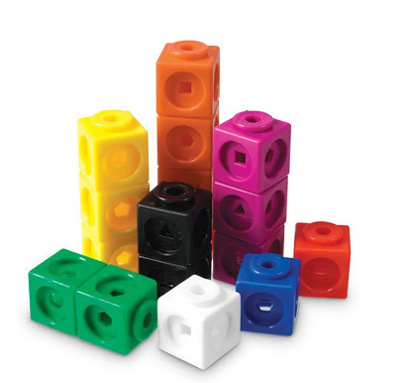

Concrete Representation
A pupil is first introduced to an idea or a skill by acting it out with real objects (manipulatives).
This is a 'hands on' component using real objects and it is the foundation for conceptual understanding.

Slide 6
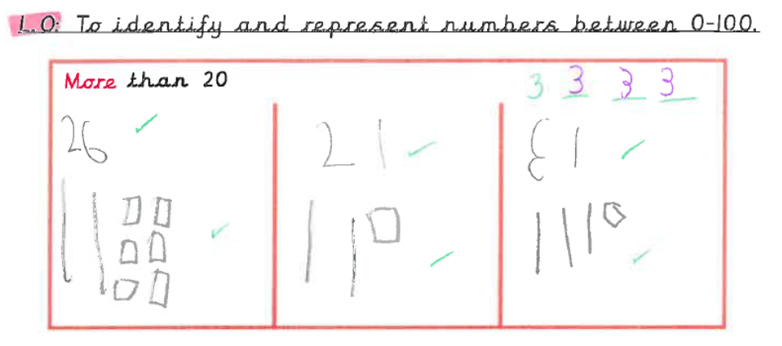
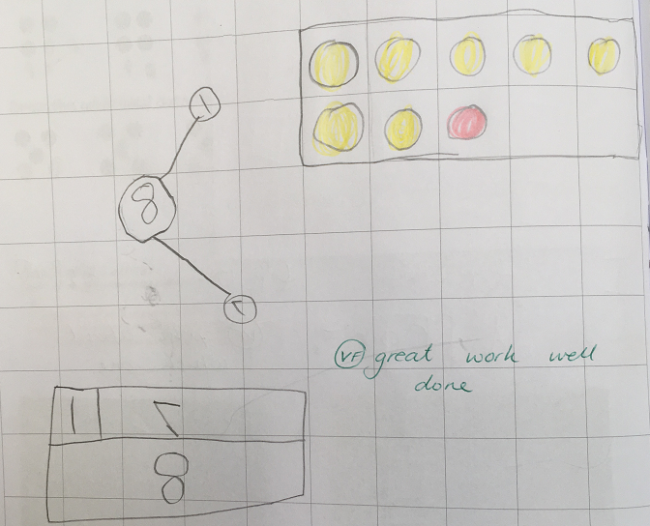
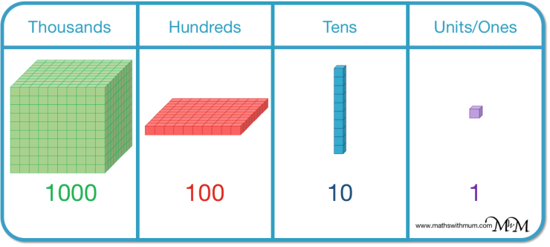
Pictorial Representation
A pupil has sufficiently understood the hands-on experiences performed and can now relate them to representations, such as a diagram or picture of the problem.

Slide 7
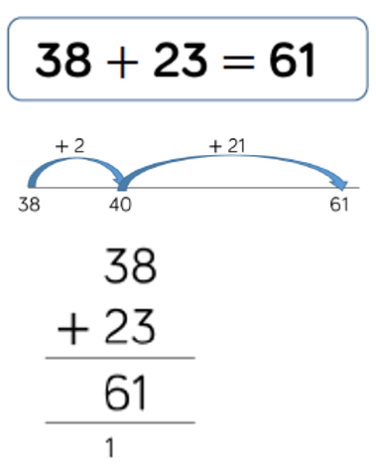
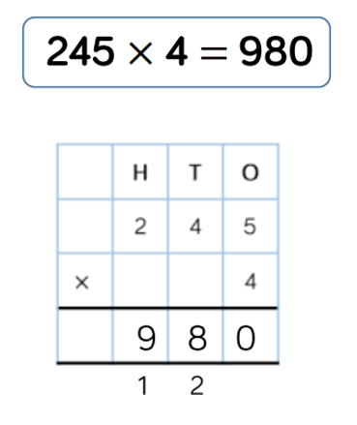
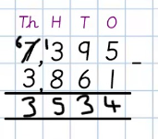
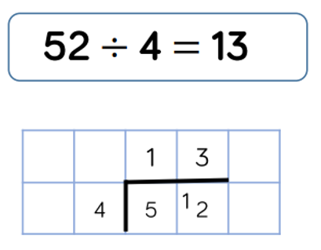
Abstract Representation
A pupil is now capable of representing problems by using numbers and mathematical notation.

Slide 8
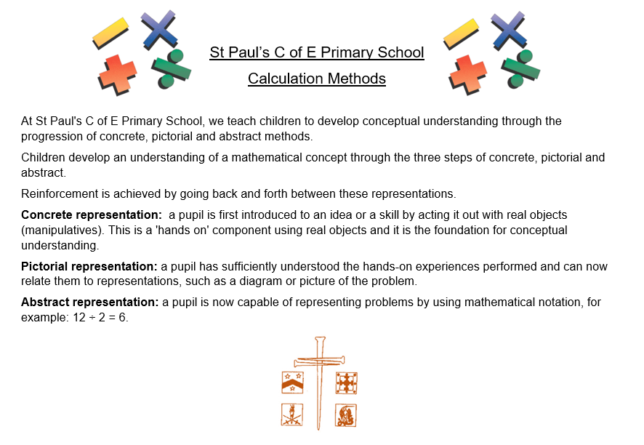
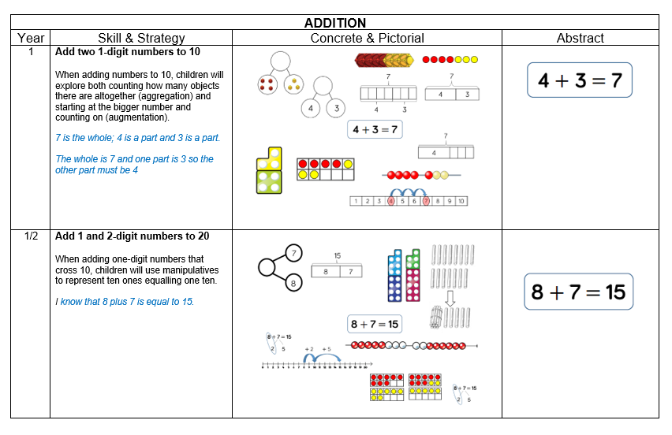
Link to St Paul's C of E Calculation Methods
https://www.saintpaulsschool.org.uk/calculations-methods/

Slide 9
What can you do at home to support your child’s learning?
Key Instant Recall Facts (KIRFs)
Instant recall of facts helps enormously with mental agility in mathematics; when children move onto written calculations and abstract methods, knowing these key facts is crucial.
For children to develop rapid recall of these facts, they need to be practised frequently and in short bursts.
Each year group has been allocated six key facts to focus on throughout the year.

Slide 10
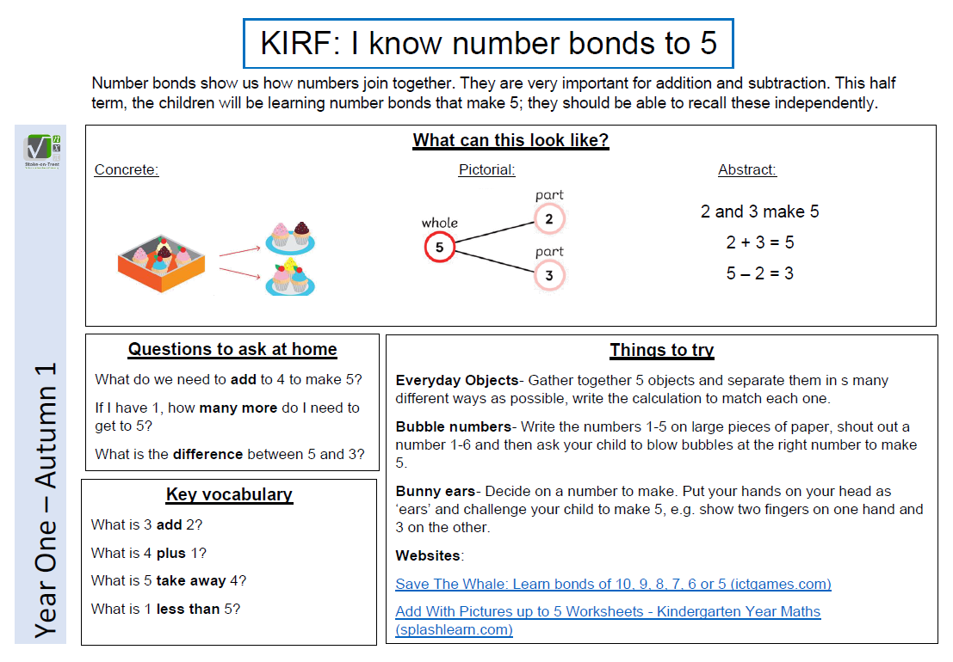
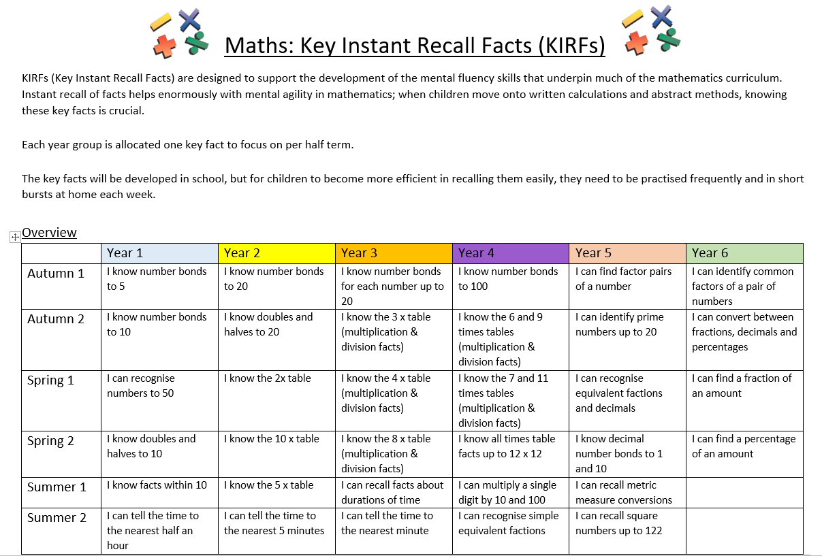
Link to half termly year group KIRFs on school website: https://stpaulswarwick.secure-primarysite.net/key-instant-recall-facts/

Slide 11
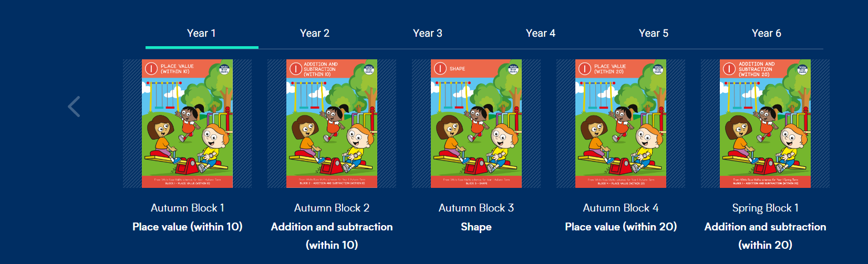
We follow the White Rose Maths scheme of learning, which promotes a mastery approach to maths.
Link to parent resources:
https://whiteroseeducation.com/parent-pupil-resources/maths/free-downloads

Slide 12
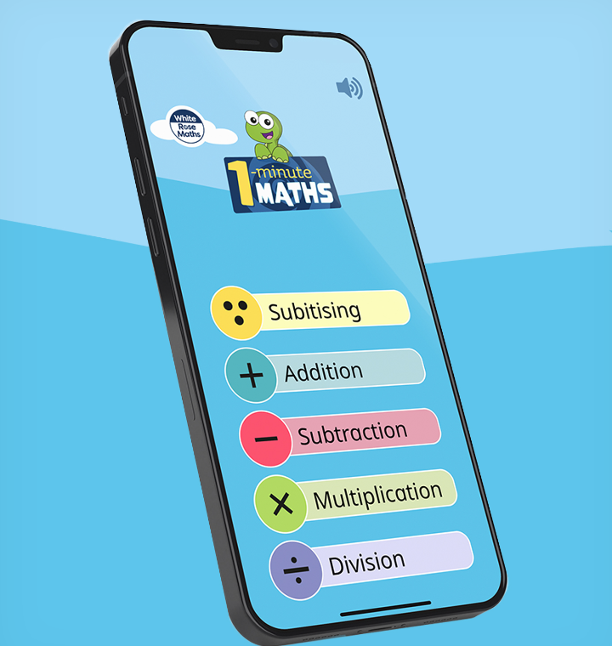
White Rose Education have produced a great app that is free to download from the app store. It’s great for all levels of primary mathematics.
Find out more using the link below.
https://whiteroseeducation.com/1-minute-maths

Slide 13

Maths Home Learning at St Paul's C of E Primary School.
All children have access to Times Table Rockstars.
Years 1-2: Class Teachers will encourage individual children to use this when they are ready.
Years 3-6: Encourage children to use at least 3x per week to promote their rapid recall of times table facts.

Slide 14
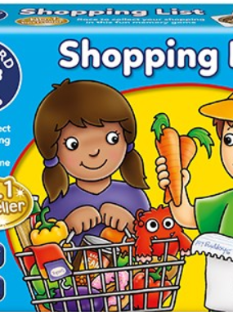

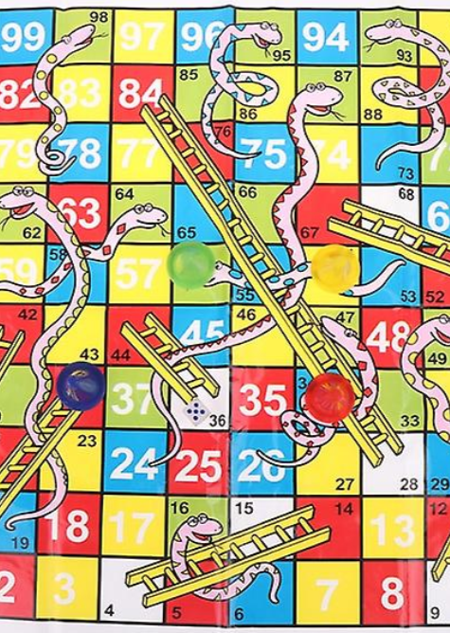
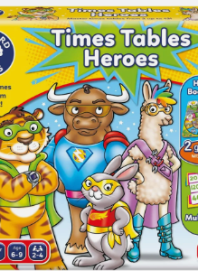
In addition to this, please play lots of number and counting games such as Snakes and Ladders with your child as well as any games using dice.

Slide 15
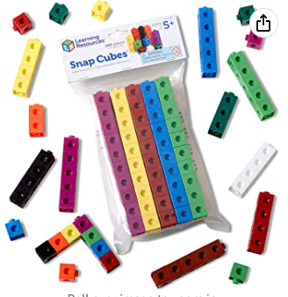
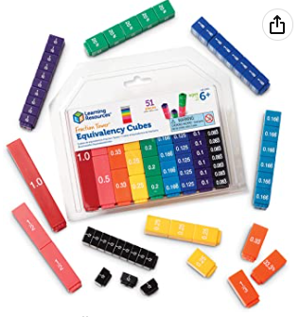
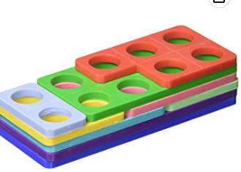
Suggested resources to support your child at home.
https://www.amazon.co.uk/Learning-Resources-Snap-Cubes-Set/dp/B000G3LR9Y/ref=sr_1_12?crid=77IR7A02BHTO&keywords=learning+resources+maths+link+cubes&qid=1672914078&s=kids&sprefix=learning+resources+maths+link+cubes%2Ctoys%2C89&sr=1-12
https://www.amazon.co.uk/Numicon-Bag-Shapes-1-10/dp/0198487312/ref=d_pd_sbs_sccl_3_4/262-3769056-4008113?pd_rd_w=GuldB&content-id=amzn1.sym.ea6fa2b9-b25b-401b-aef1-8543b649508d&pf_rd_p=ea6fa2b9-b25b-401b-aef1-8543b649508d&pf_rd_r=M3B45GXJEJGVHCBDPQD1&pd_rd_wg=Q2U1C&pd_rd_r=28dcbbf1-1508-4621-bd92-7e06b772c6b6&pd_rd_i=0198487312&psc=1
https://www.amazon.co.uk/Learning-Resources-LSP2509-UKM-Fraction-Equivalency/dp/B000296LSO/ref=sr_1_4_mod_primary_new?crid=1WBCALVCE44T3&keywords=learning%2Bresources%2Bfraction%2Btowers&qid=1672914315&s=kids&sbo=RZvfv%2F%2FHxDF%2BO5021pAnSA%3D%3D&sprefix=learning%2Bresources%2Bfraction%2Btowers%2Ctoys%2C161&sr=1-4&th=1

