Slide 1
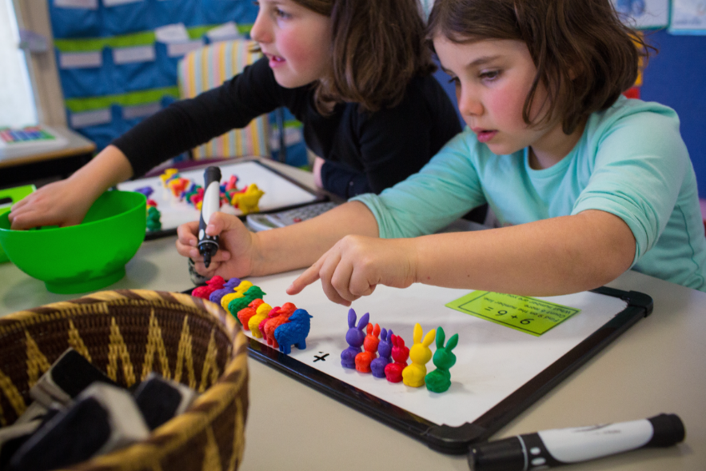
At St Paul’s we aim to ensure that all children:
Enjoy maths
Experience success
Become confident in their ability to apply their mathematical skills in a range of contexts
Recognise the importance and relevance of Maths in the wider world
Develop mathematical resilience

Slide 2
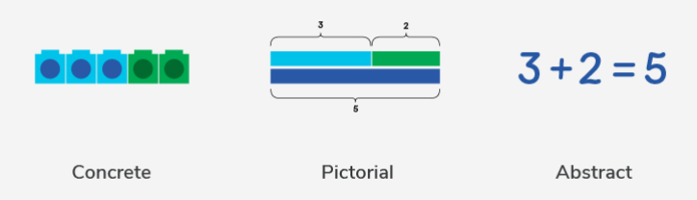
Children learn new concepts through the concrete, pictorial, abstract approach.
Reinforcement is achieved by going back and forth between these representations.

Slide 3
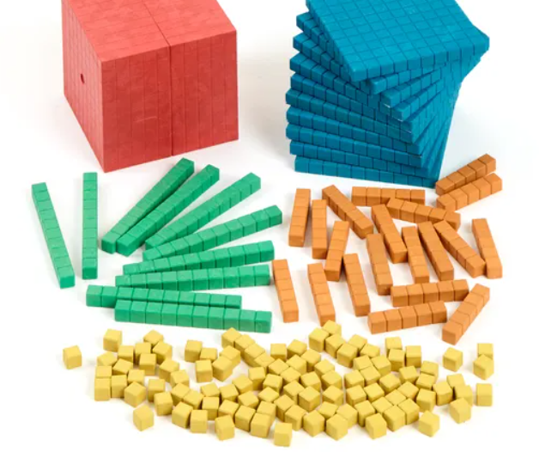
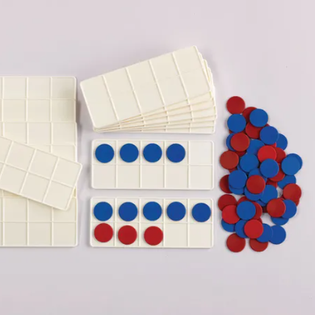
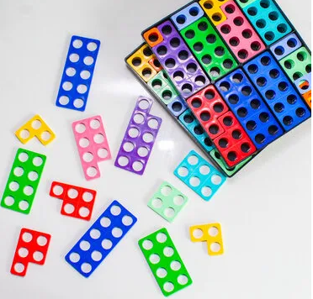
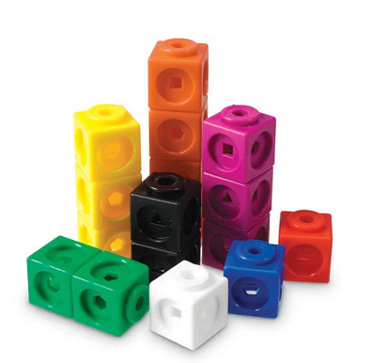

Concrete Representation
A pupil is first introduced to an idea or a skill by acting it out with real objects (manipulatives).
This is a 'hands on' component using real objects and it is the foundation for conceptual understanding.

Slide 4
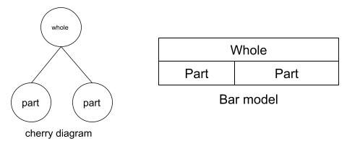
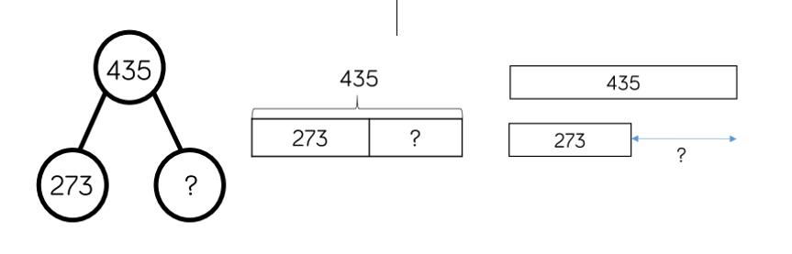
Pictorial Representation
A pupil has sufficiently understood the hands-on experiences performed and can now relate them to representations, such as a diagram or picture of the problem.
435 – 273 = ?

Slide 5
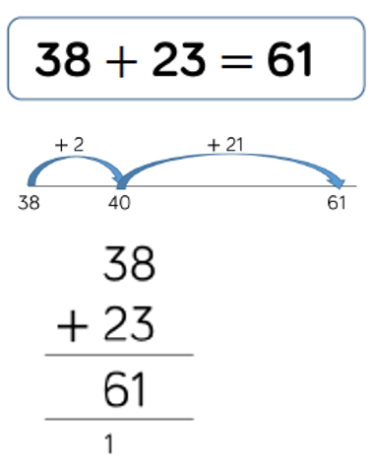
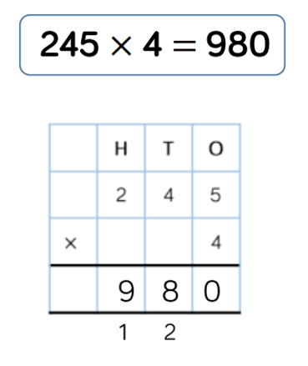
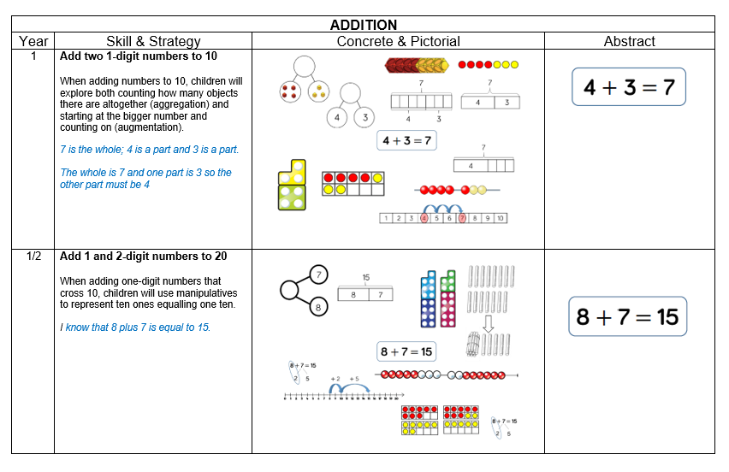
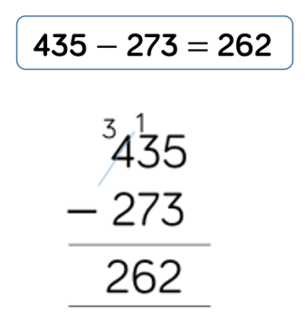
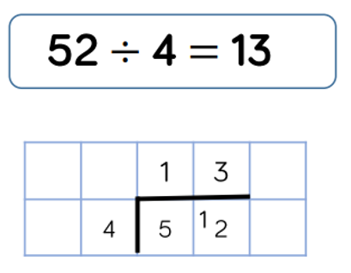
Abstract Representation
Pupils are now capable of representing problems by using numbers and mathematical notation.
Link to St Paul's C of E Calculation Methods:
https://www.saintpaulsschool.org.uk/calculations-methods/
162
162

Slide 6

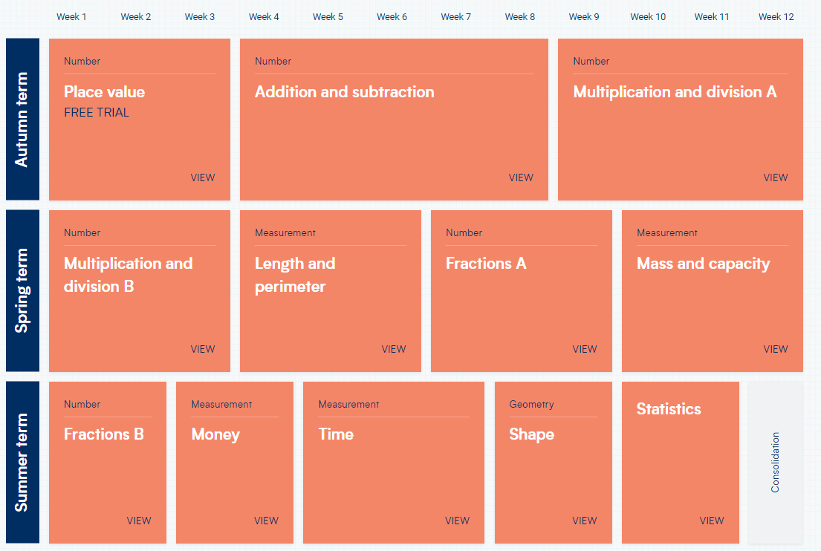
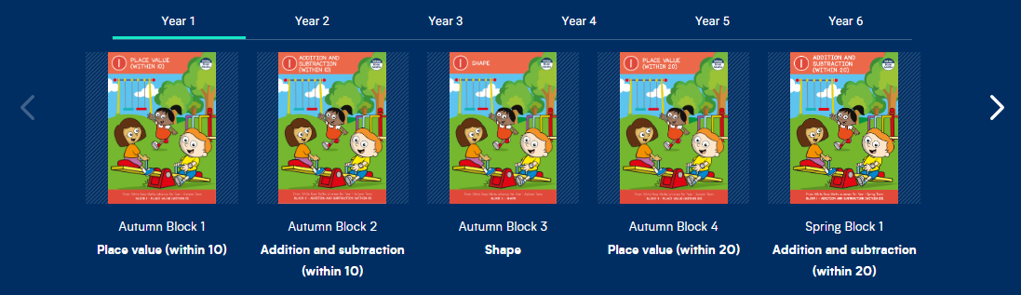
We follow the White Rose Maths scheme of learning, which promotes a mastery approach to maths.
Topics are broken up into units of learning and then further broken up into small steps (lessons).
Link to yearly overview of topics for each year group:
https://whiteroseeducation.com/resources?year=year-1-new&subject=maths
Link to White Rose Maths Parent Resources:
https://whiteroseeducation.com/parent-pupil-resources/maths/free-downloads

Slide 7
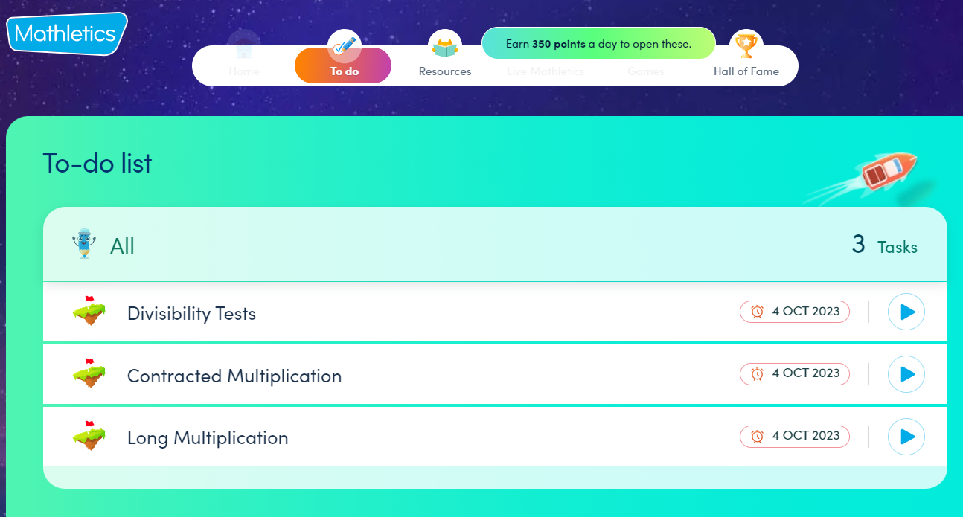
Maths Home Learning at St Paul's C of E Primary School.
Year 3 and 4- Children will be set a short piece of maths homework each week to be completed in their Home Learning books.
Tasks will be set on a Friday and there will be an expectation that they are handed back in on Thursday.
Year 5 and 6- Children will be assigned three weekly Mathletics tasks linked to their learning in school.
Tasks will be set on a Wednesday and there will be an expectation that they are completed by the following Wednesday.
Year 5/6 children have been given a login to Mathletics.
https://login.mathletics.com/

Slide 8
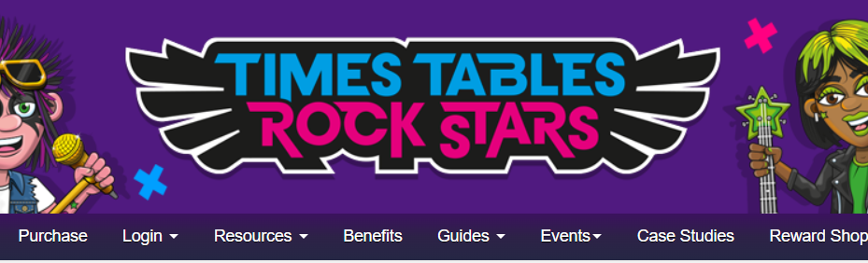
Maths Home Learning at St Paul's C of E Primary School.
All children have been given a login to Times Table Rock Stars.
Years 3-6: Encourage children to use at least 3x per week to promote their rapid recall of times table facts.
https://ttrockstars.com/

Slide 9
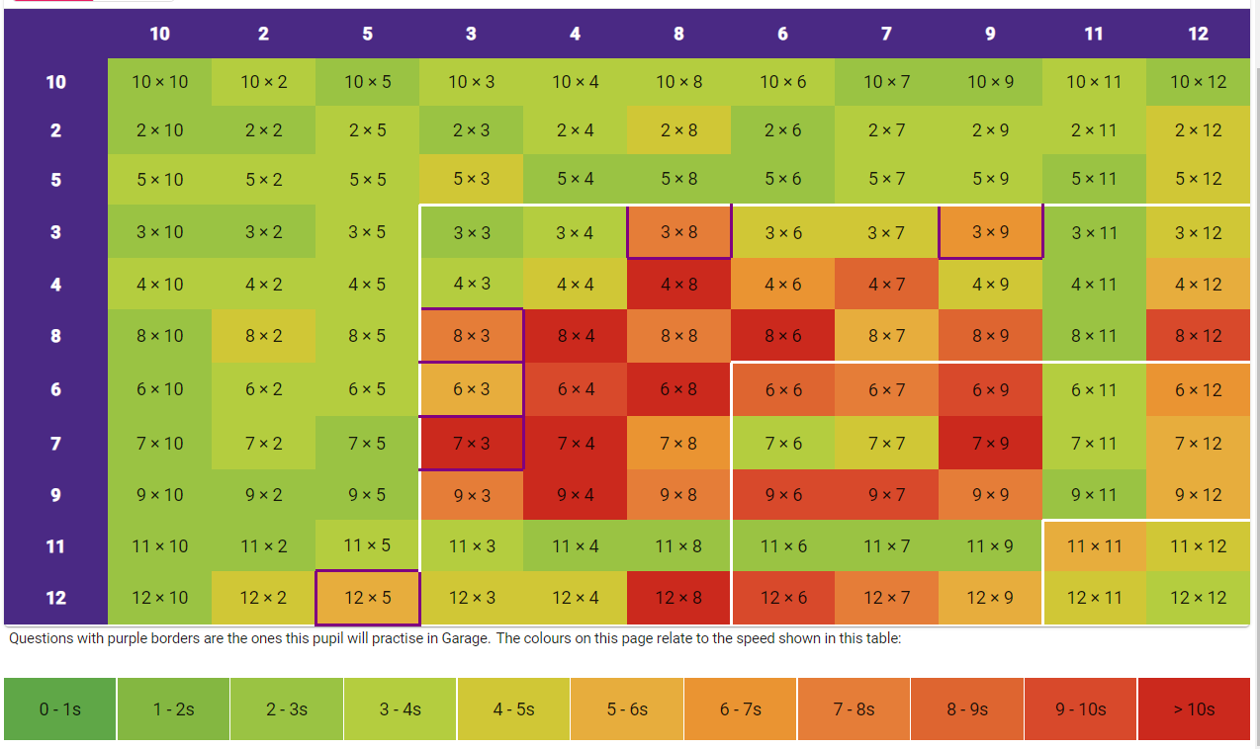
Times table fluency – heat map

Slide 10
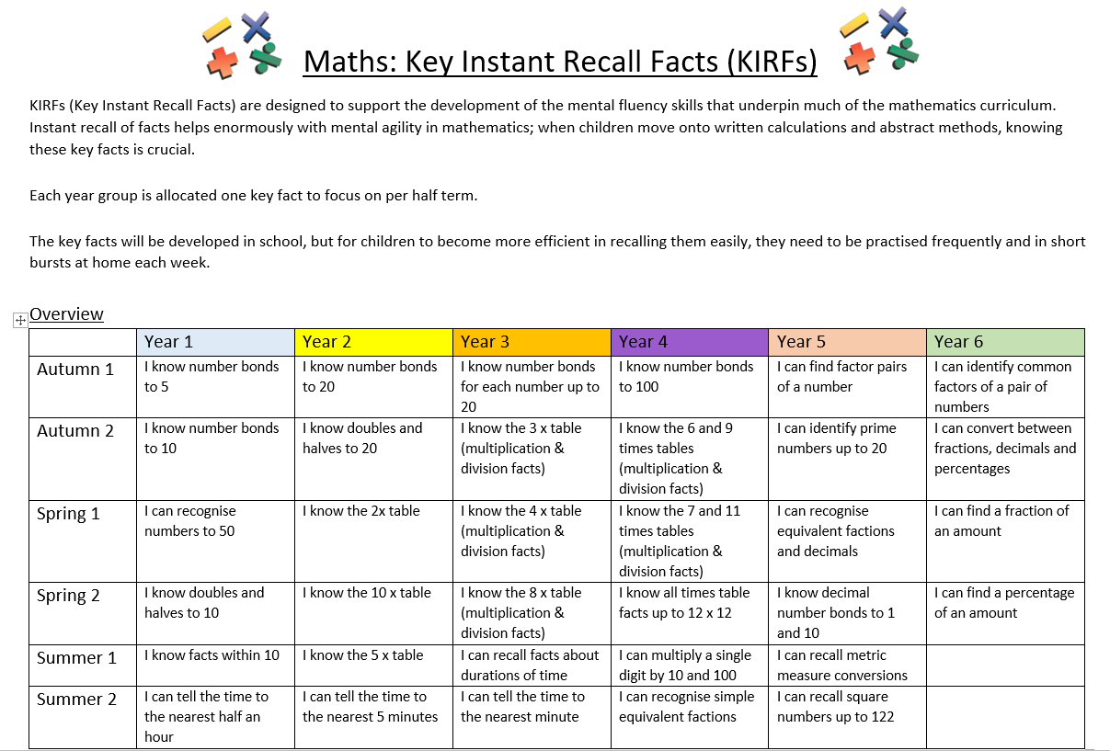
Link to half termly year group KIRFs on school website: https://stpaulswarwick.secure-primarysite.net/key-instant-recall-facts/
How can you help your child develop mental fluency?

Slide 11
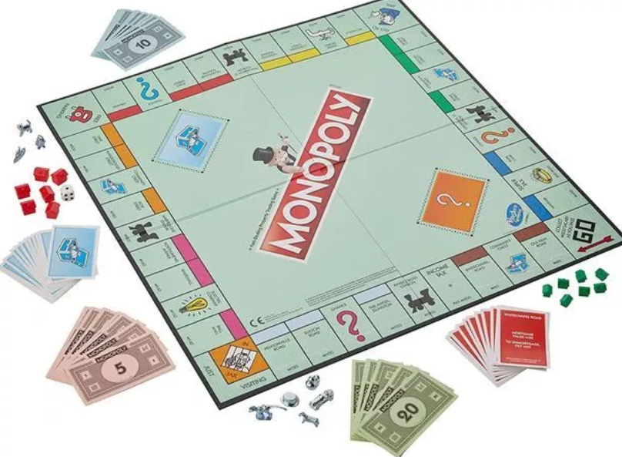
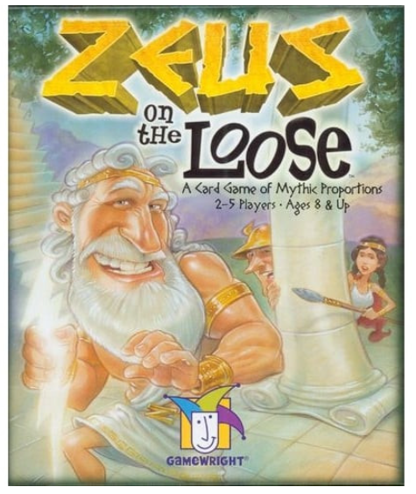
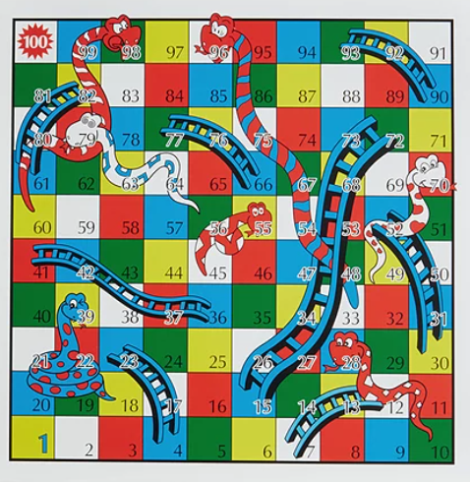
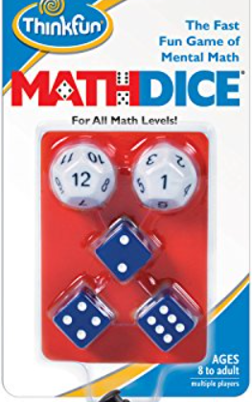
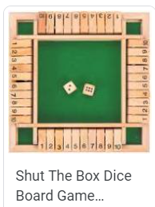

Play board games!

Slide 12
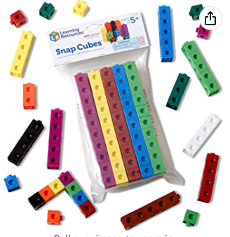
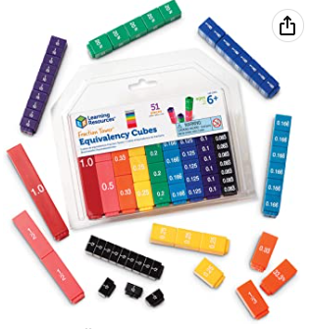
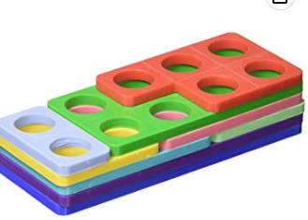
Suggested resources to support your child at home.
https://www.amazon.co.uk/Learning-Resources-Snap-Cubes-Set/dp/B000G3LR9Y/ref=sr_1_12?crid=77IR7A02BHTO&keywords=learning+resources+maths+link+cubes&qid=1672914078&s=kids&sprefix=learning+resources+maths+link+cubes%2Ctoys%2C89&sr=1-12
https://www.amazon.co.uk/Numicon-Bag-Shapes-1-10/dp/0198487312/ref=d_pd_sbs_sccl_3_4/262-3769056-4008113?pd_rd_w=GuldB&content-id=amzn1.sym.ea6fa2b9-b25b-401b-aef1-8543b649508d&pf_rd_p=ea6fa2b9-b25b-401b-aef1-8543b649508d&pf_rd_r=M3B45GXJEJGVHCBDPQD1&pd_rd_wg=Q2U1C&pd_rd_r=28dcbbf1-1508-4621-bd92-7e06b772c6b6&pd_rd_i=0198487312&psc=1
https://www.amazon.co.uk/Learning-Resources-LSP2509-UKM-Fraction-Equivalency/dp/B000296LSO/ref=sr_1_4_mod_primary_new?crid=1WBCALVCE44T3&keywords=learning%2Bresources%2Bfraction%2Btowers&qid=1672914315&s=kids&sbo=RZvfv%2F%2FHxDF%2BO5021pAnSA%3D%3D&sprefix=learning%2Bresources%2Bfraction%2Btowers%2Ctoys%2C161&sr=1-4&th=1

Slide 13


