Slide 1

English at St Paul’s
Key Stage 1

Slide 2

Phonics at St Paul’s

Slide 3
Little Wandle Letters and Sounds Revised
Our school has chosen
Little Wandle Letters and Sounds Revised as our systematic, synthetic phonics (SSP) programme to teach early reading and spelling.

Slide 4
Blending to read words…
We teach the children the sounds
Children then blend the sounds together to read a word
This takes practice
Some children learn to blend really quickly, and others take a little longer.

Slide 5
Terminology - used across the whole school
Phoneme
Split vowel digraph
Grapheme
Blend
Digraph
Segment
Trigraph
Notes:
Explain what each word means – use our glossary to help: https://www.littlewandlelettersandsounds.org.uk/resources/my-letters-and-sounds/getting-started/

Slide 6


Teaching order – 4 new sounds a week + a review lesson
Notes:
We usually teach four new sounds a week and have a review lesson on a Friday. You will get a list of the sounds that we are learning to have at home. This will help you with formation and pronunciation.

Slide 7


Gradually your child learns the entire alphabetic code:
Notes:
We will work our way through the whole Little Wandle Programme until your child can read fluently.

Slide 8
Reading and spelling
at St Paul’s

Slide 9


Reading and spelling
Children learn that there are graphemes that can have different sounds and sounds that can be made with different letters
Notes:
This is an example of what the children learn in Year 1.
Children learn that there are graphemes that can have different sounds and sounds that can be made with different letters.
Use the backs and fronts of Phase 5 cards to show ‘ea’ and ‘ow’.

Slide 10
Another example…all the different ways to write the phoneme sh:
shell
chef
special
caption
mansion
passion

Slide 11
Tricky Words…
Also known as Common Exception Words
The have irregular spelling patterns and cannot be decoded for reading and writing using phonics.
They need to be learned by sight, off by heart
Examples include:
Said – pronounced sed
Was – pronounced woz
They – pronounced thay

Slide 12
Spelling
Say the word.
Segment the sounds.
Count the sounds.
Write them down.
Notes:
Model the process on a flipchart for the parents to see.

Slide 13
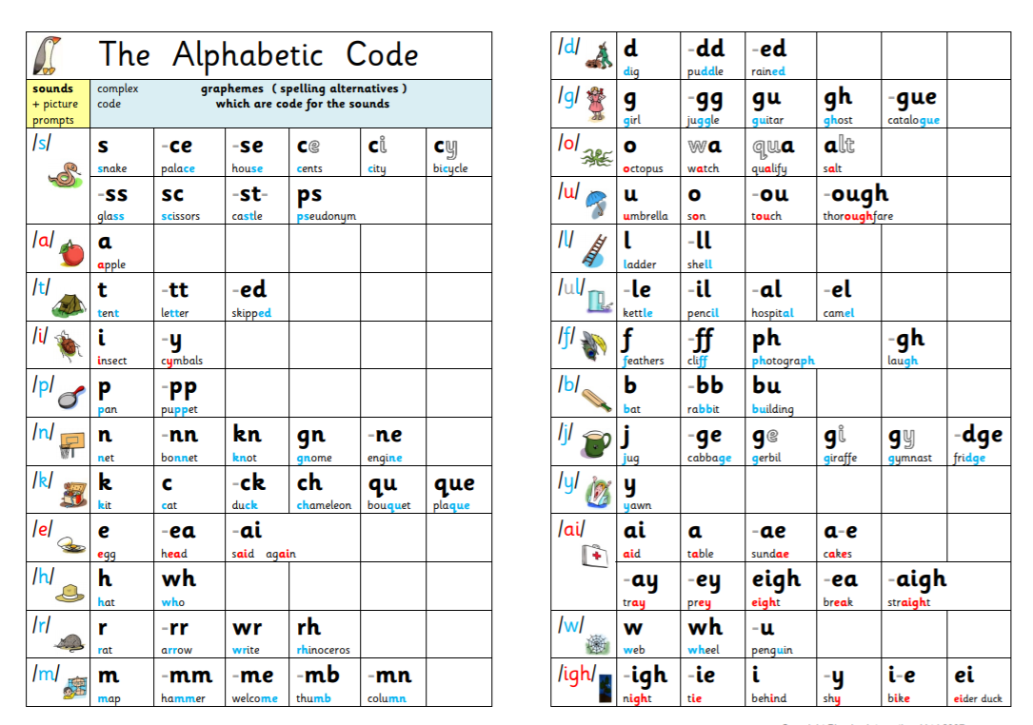
Graphemes for Spelling …
There are 44 phonemes (sounds), but there are around 250 graphemes (letters or letter groups that correspond to a single sound).
This is because every phoneme corresponds to more than one grapheme (letter or letter groups) across different words.

Slide 14
How do we teach reading in books?
Reading practice sessions are:
timetabled three times a week
taught by a trained teacher/teaching assistant
taught in small groups.
Notes:
The children read the same book three times in a week. The first time we work on decoding (sounding out) the words, the second time we work on prosody which is reading with expression – making the book sound more interesting with our story-teller voice or our David Attenborough voice – and the third time we look at comprehension. We read the books three times at school because we want to develop the fluency. The more they see words the more they begin to read them automatically without having to sound them out.

Slide 15

We use assessment to match your child the right level of book
Notes:
We assess your child every six weeks to check progress. Any child who needs extra support has daily keep-up sessions planned for them.

Slide 16
Reading a book at the right level
This means that your child should:
Know all the sounds and tricky words in their phonics book well
Read many of the words by silent blending (in their head) – their reading will be automatic
Only need to stop and sound out about 5% of the words by the time they bring the book home – but they should be able to do this on their own.

Slide 17
Reading and Spelling in Year 2
Focus moves to progressive fluency (automaticity in word reading in increasingly challenging texts) and building on the comprehension skills of retrieval, prediction and inference.
Similarly to Year 1 the children read in groups
Eventually they will move to whole class reading in preparation for LKS2
Again, like Year 1, the children will bring home a book closely matched to their phonics level plus 2 books to share
Children in Year 2 begin to learn spelling rules as detailed in the National Curriculum, using the Spelling Shed Scheme – which continues as they move to KS2.

Slide 18
Supporting your child
reading and phonics at home

Slide 19
The most important thing you can do is read with your child
Reading a book and chatting had a positive impact a year later on children’s ability to…
understand words and sentences
use a wide range of vocabulary
develop listening comprehension skills.
The amount of books children were exposed to by age 6 was a positive predictor of their reading ability two years later.
Parental involvement in the development of children’s reading skills: A five-year longitudinal study (2002) Senechal, M. and Lefvre, J
Notes:
Celebrate child’s success at school, make time for reading at home!

Slide 20

Books going home
Notes:
As well as the ‘learning to read’ book that your child will bring home they will also bring home a book for sharing with you. This book is SO important. This is how we are going to give them the WILL to read. Please read with your child as often as you can – at least once a day if possible.

Slide 21
Listening to your child read their phonics book
Your child should be able to read their book without your help.
If they can’t read a word read it to them.
Talk about the book and celebrate their success.

Slide 22

Supporting your child with phonics – LW parent videos on our website…
Notes:
It is really important that you pronounce the sounds correctly at home if you are supporting your child. These videos are on the website for you to refer to and if you are unsure, please ask your child’s teacher.
Show the parents where to access the videos on the website and play them!
https://www.littlewandlelettersandsounds.org.uk/resources/for-parents/

Slide 23
Read to your child
The shared books are for YOU to read:
Make the story sound as exciting as you can by changing your voice.
Talk with your child as much as you can:
  Introduce new and exciting language
  Encourage your child to use new vocabulary
  Make up sentences together
  Find different words to use
  Describe things you see.

Slide 24
In Year 1, all book bags must be brought into school on a TUESDAY with the phonic reading book, reading diary and reading for pleasure books inside.
Books are sent home on a Thursday following Reading Practice sessions.
On the days you do not have the school reading books at home you can support your child to read using books from the library, and by reading their familiar books at home. Remember that repetition always helps support their language and reading development.
Please look after the books- the scheme is very new and very precious!

Slide 25
Year 2 – Supporting Spelling at home
Your children are now beginning to learn spelling rules as detailed in the National Curriculum
There are 25 rules plus the common exception words
The children will look at a new rule each week
A paper copy of the words will be sent home
They will also be set on Spelling Shed – the online spelling platform we use at St Paul’s from Year 2 upwards

Slide 26
Writing in Key Stage 1

Slide 27
Handwriting…transcription
Is taught in discrete lessons in Key Stage 1
Basic Letter formation
Pre cursive
In preparation for continuous cursive (joined handwriting)
in Key Stage 2

Slide 28
Composition…
In Year 1:
Initially, we use dictated sentences to reduce cognitive load
These dictated sentences will only contain words that the children can segment for spelling using their phonics knowledge and the tricky words learned
We encourage all children to have a go at writing as phonetically correct spelling is acceptable
We move on to lots of oral rehearsing of sentences – often adding actions to them before then writing them down
By the end of Year 1, children need to be able to write a sentence that starts with a capital letter and end with a full stop
We have high expectations for all children and of course most will far exceed this expectation
In Year 2:
We teach the children about the 4 sentence types thereby introducing a ? and !, along with the .
They begin to learn about the features of different text types e.g. instructions, narrative, poetry, non-chronological report
We begin to teach them additional grammar, punctuation, sentence structures and word classes.

Slide 29
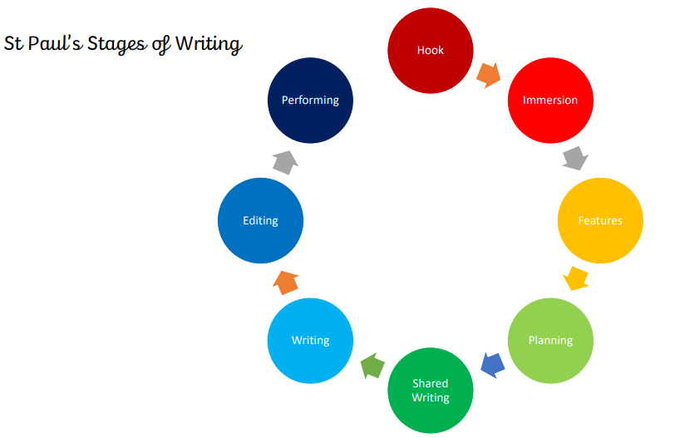
Writing – Stages of Writing
From year 1 through to year 6 we use the ‘Stages of Writing’ document.
Each stage is taught either in a lesson or across a series of lessons.
The aim is for children to develop an understanding of the methodical approach to understanding, planning and writing a piece of writing.

Slide 30


