Slide 1


Welcome to Year 3 & 4
(Lower Key Stage 2)

Slide 2

Lower Key Stage 2 Staff:
LKS2 Teaching Staff
3A: Mrs Clarke (Mon-Wed) & Mrs Young (Thurs/Fri)
3/4B: Mrs Newbold
4C: Mrs Bown / Mrs Newell
PPA Cover (Tuesday Afternoon)
French: Mrs Crow
Music: Mrs Mottram
PE: Mr Barnes
Our brilliant teaching assistants:
Miss Mancini
Mrs Lord
Mrs Wells (Mon-Tues)
Mrs Reynolds
Mr Barnes

Slide 3
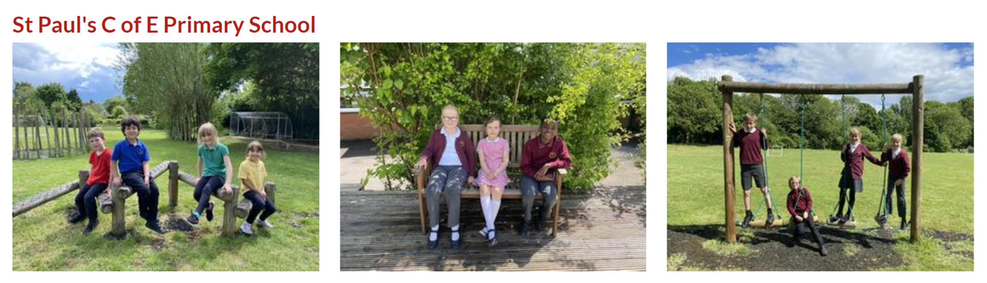
School Uniform
It is important that children come to school in the correct uniform. This is detailed in the school uniform policy.
https://www.saintpaulsschool.org.uk/school-uniform/
PLEASE NAME ALL ITEMS of CLOTHING & PROPERTY

Slide 4
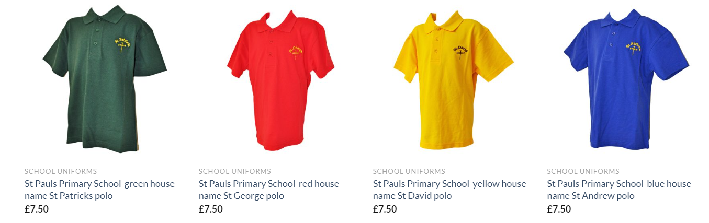
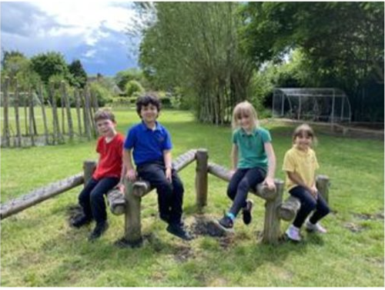
P.E: 2 sessions per week
PLEASE NAME ALL ITEMS of CLOTHING & PROPERTY
PE Kit – wear to school
a plain top in their house colour
Black shorts/leggings/joggers
Trainers
School jumper

Slide 5
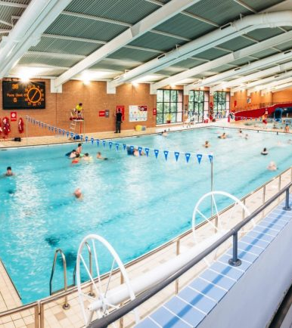
Swimming
Each class gets 2 blocks of swimming sessions across the year.
LKS2 classes swim on a Wednesday.
Your child will need to be dropped off at Newbold Comyn swimming pool by 08:45. Breakfast club children will walk from school at 08:35 with an adult.
Children will need a towel, goggles and a swimming cap if they have long hair. Earrings will need to be removed.
Parents are unfortunately not allowed to watch.

Slide 6
Class pages:
A great source of information updated before each new half term starts:
PE Days
Homework expectations
½ termly overviews of learning
Important dates
Notices
Please direct all emails to admin

Slide 7
What will my child need to bring to school?
We will provide children with everything that they need for lessons. They do not need to bring in their own pencil case.
Children should bring in a labelled drinks bottle with water.
Children should bring a coat to school everyday.
Children should come to school dressed in a PE kit on the days they have PE.

Slide 8

Weekly Maths Homework
We will send Maths homework out each Friday linked to the work we have covered in class that week. This should be returned the following Thursday.
We recommend that children access Times Table Rockstars at least 3 times a week to ensure they maintain rapid recall of their times and division facts up to 12 x 12
All passwords and logins will be stuck inside the front cover of their homework book.

Slide 9
Weekly Spellings Homework
Monday:
Spelling lesson introducing the week's spelling rule
Children to choose 5 spelling words out of the 10 spellings.
Homework:
Children to write a neatly written, correctly punctuated and interesting sentence for each of the 5 words. Hand in by Thursday.
Please look at your child's sentences with them.
We will use these spellings in dictated sentences in class throughout the week.

Slide 10

Encourage your child to read every day.
Read with your child whenever possible.
Children have access to books in school which they can bring home.
The children will have reading diaries to keep a record of books read.
Reading will be our focus for at least the first half term, offering interventions where necessary to support children towards expected Y3 levels.
There is an expectation that all children will bring their reading diary and books into school at least every two weeks, regardless of whether the book is finished. This is to allow us to monitor their reading.

Slide 11

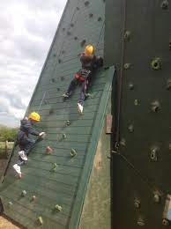
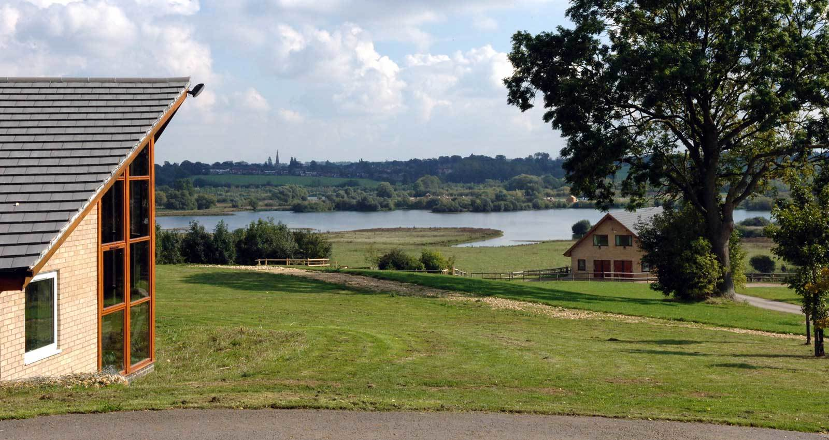
Year 4: Frontier Centre Residential - 2 nights in May 2027

Slide 12

Allergy Awareness
Fruit is not provided for snack times in Key Stage Two – please provide your child with a snack for breaktime (nut and dairy free)
Please provide your child with a change of clothes to hang on their peg

Slide 13


