Slide 1


Welcome to Year 5 & 6
(Upper Key Stage 2)

Slide 2

Upper Key Stage 2 Staff:
UKS2 Teaching Staff
5/6A: Mrs Williams (Mon-Wed) & Mrs Crow (Thurs/Fri)
5/6B: Mrs Lee
5/6C: Mr Filby
PPA Cover (Wednesday Afternoon)
French – Mrs Crow
PE – Mr Barnes
Music – Mrs Mottram
Forest School
Mrs Berte
Our brilliant teaching assistants:
Mrs Seymour
Miss Curran
Mr Turner
Miss Willshee
Notes:
PH + ALL

Slide 3
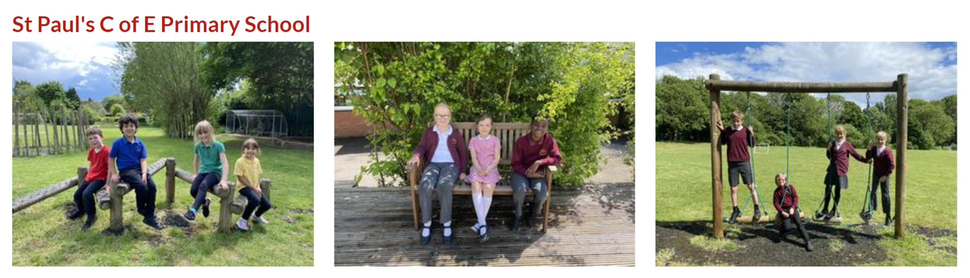
School Uniform
It is important that children come to school in the correct uniform. This is detailed in the school uniform policy.
https://www.saintpaulsschool.org.uk/school-uniform/
PLEASE NAME ALL ITEMS of CLOTHING & PROPERTY
Notes:
PH

Slide 4
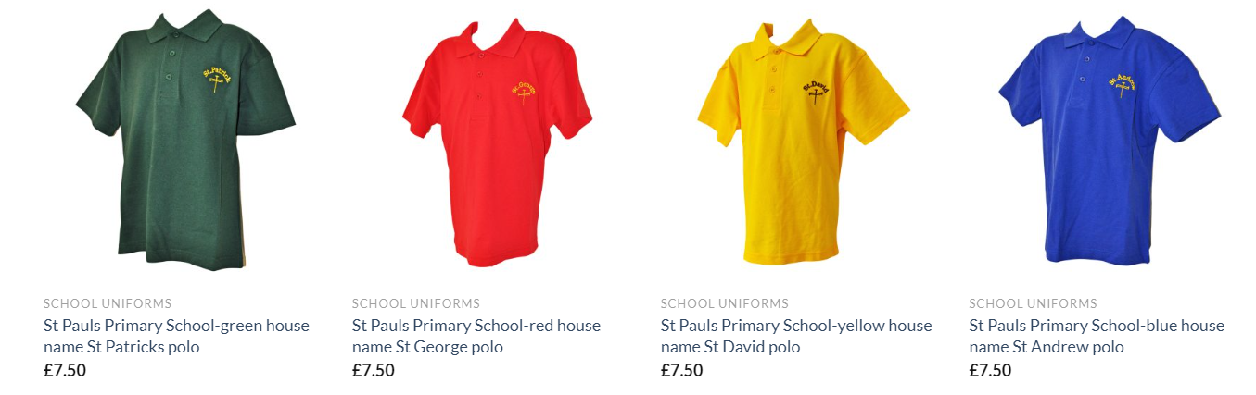
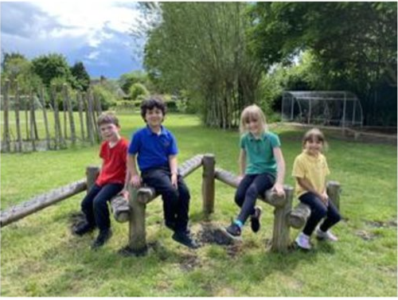
P.E: 2 sessions per week
Wednesday (Mr Barnes) - unless swimming
Thursday morning or Friday afternoons
PLEASE NAME ALL ITEMS of CLOTHING & PROPERTY
PE Kit – wear to school
a plain top in their house colour
Black shorts/leggings/joggers
Trainers
School jumper
Notes:
PH

Slide 5
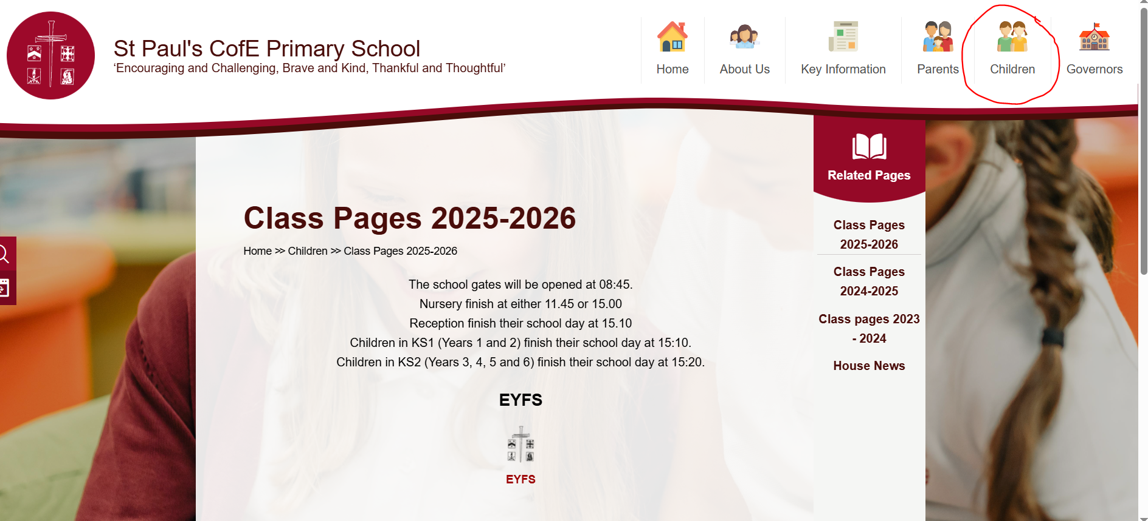
Class Pages
A great source of information:
PE Days
Homework expectations
Timetable
½ termly overviews of learning
Important dates
Notices
Email addresses
Notes:
PH

Slide 6
What will my child need to bring to school?
We will provide children with everything that they need for lessons. They do not need to bring in their own pencil case.
Children should bring in a named drinks bottle with water.
Children should bring a coat to school everyday.
Children should come to school dressed in a PE kit on the days they have PE.
Notes:
JL

Slide 7
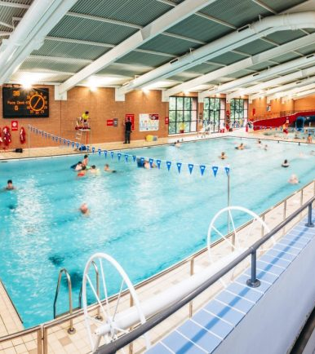
Swimming
Each class gets 2 blocks of swimming sessions across the year.
Year 5/6 classes swim on a Thursday.
Your child will need to be dropped off at Newbold Comyn swimming pool by 08:45 or meet their teacher at school at 08:30 to walk with them to the pool.
Children will need a towel, goggles and a swimming cap if they have long hair.
Notes:
JL

Slide 8

Teaching in Upper Key Stage 2
On the first day we will stay in our classes to allow children to settle and get to know their teachers and peers.
After that:
Register in their Registration class (5/6A, 5/6B & 5/6C)
AM – Children move into morning classes
Maths
Shared reading
Spellings
English
PM – Children return to their registration class (5/6A, 5/6B & 5/6C)
A range of subjects such as art, music, history, geography, DT, PE, computing and science
Notes:
BC

Slide 9


Home Learning Expectations:
Encourage your child to read every day.
Read with your child whenever possible.
Children have access to books in school which they can bring home.
Reading diaries will be kept in school to keep a record of books read.
Notes:
JW

Slide 10
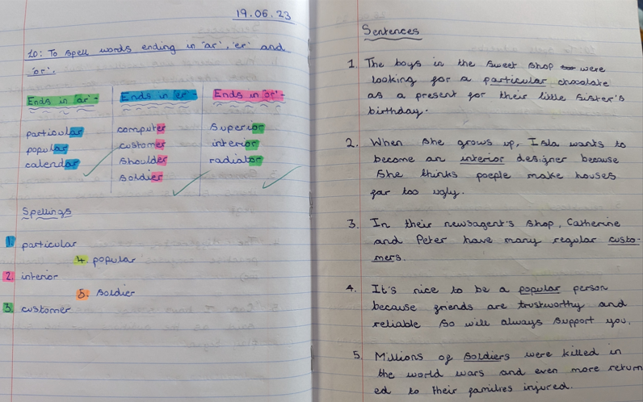
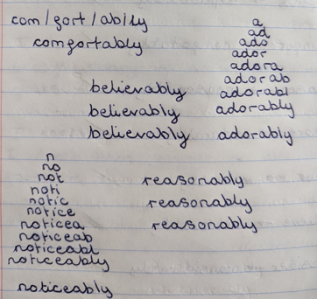
Weekly Spellings' Homework
Monday:
Spelling lesson introducing the week's spelling rule
Children to choose 5 spelling words out of the 10 spellings.
Children to practise and learn all 10 spellings throughout the week.
Homework:
Children to write a neatly written, correctly punctuated and interesting sentence for each of the 5 words. Hand in by Friday.
Please look at your child's sentences with them.
Friday:
Children will be tested on the 10 spellings through dictated sentences.
Notes:
BC

Slide 11

Weekly Maths Homework
Children will be given a Maths homework sheet on a Wednesday, linked to their learning in school. Due back in by the following Tuesday.
We recommend that children access Times Table Rockstars a few times a week to ensure they maintain rapid recall of their times and division facts up to 12 x 12
Notes:
JW

Slide 12


Maths and English parent Workshop in the
Autumn Term
Notes:
JW

Slide 13

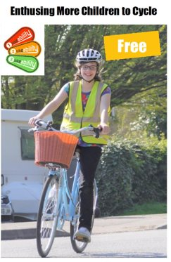
Year 6 Residential - 8th – 12th March 2027
Year 6s: Longtown Residential
We will hold an information evening closer to the residential date.
Year 6s: Bikeability - 5th Oct 2026
Opportunity to complete Level 2 Bikeability training – no cost.
Notes:
JL / JW

Slide 14


Slide 15


