Slide 1

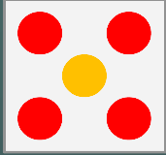


St Paul's C of E Primary School
Reception Maths Parents Meeting

Slide 2
Children and grown-ups will work through the session materials, guided by the class teacher. These will cover:
Reception
Subitising
Composition
3 or NOT 3
Part-part-whole activities with images.
Notes:
Hidden slide for teacher info only

Slide 3
Aims of the session
To share with you some of the things your child will be learning in school
To improve your confidence in helping your child with maths
To create some games and activities for use at home
To share with you the home learning activities

Slide 4
Teaching maths in Reception at St Paul's
At St. Paul's we teach maths through a mastery approach. But what does that mean?
Mathematics teaching for mastery assumes everyone can learn and enjoy mathematics.
Mathematical learning behaviours are developed such that pupils focus and engage fully as learners who reason and seek to make connections.
Curriculum design ensures a clear and detailed sequence of essential content to support sustained progression over time.

Slide 5
To do this we use NCETM Mastering Number.
This is used throughout the school and builds on what the children learn in Reception.

Slide 6
Why should you help your child at home?
The help that parents give their children at home has a very significant impact on their learning.
Development Matters (2023)
Notes:
Point out to parents that research proves that high quality teaching in school is key to raising attainment. But their role is also really important!
If parents understand how their children are being taught in school, then this can have a dramatic impact on children’s outcomes (and confidence), even in schools that are already successful.

Slide 7





How does Mastering Number help us to teach maths in school?
The Mastering Number Programme in Reception will help your child to develop good number sense.
Some of the things they are learning include:
Know different ways to ‘make’ (compose) a number
Counting
Recognising small numbers of objects and making their own collections
Notes:
The MN Programme is a new national programme based on research into what is important in early maths education.
‘Number sense’ includes lots of things; the things mentioned here are some of them, but we are only going to focus in this session on the second and third ones.
It is worth mentioning to parents here that the numbers children use may be smaller than what they can do at home, but we are purposefully focusing on smaller numbers so that the children can develop a deep understanding of numbers to develop that strong number sense.
Children will be learning gradually to count out larger sets of objects and join in with the counting numbers, but to have a really good foundation to build on, the smaller numbers are so important.
NB - all of these things are part of the Early Learning Goal for number.
At this point the children should come into the classroom/hall to join their grown-up.

Slide 8

Let’s do some maths!
Look out for when you can use your subitising skills! Get those fast eyes ready!
Notes:
You might want to prompt adults to think about what we are meaning here by ‘numbers’. We are focusing on the objects, not on written numbers as digits.
Rather than explaining what subitising is, we are going to have a go at it.
In a moment, I will flash an image on the screen with some trees. I just need you to shout out how many trees you can see. It’s not a trick question, just shout out how many there are.
Get your fast eyes ready, as it will only appear for a second or two.
Let’s have a go at ‘subitising’ – can you say how many things you can see? Sometime you might NOT be able to subitise!
Show next slide for 2/3 seconds.

Slide 9
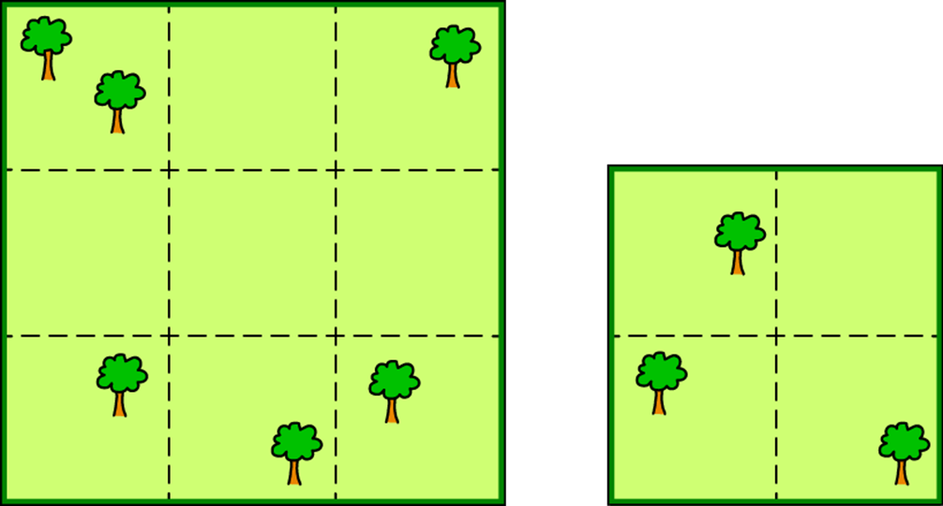

Slide 10
Notes:
Ask the grown-ups – How many did you see? Yes, 3.
How do you know?
Take suggestions - some parents say, ‘I counted.’ Was there time for that?
Some say ‘I just knew.’ Others will say ‘I know I just saw three.’
Would it make a difference if it was three dogs or flowers or cars?
No, we just know instinctively what three looks like. Haylock calls this ‘ knowing the threeness of three.’ This is what is known by subitising.
And research suggests that it is something that is instinctive - and is one of the first and main abilities very young children should develop (from Clements and Sarama)
Let’s have another try.
How many this time? – flash next screen for 2/3 seconds.

Slide 11


Slide 12
Notes:
Take suggestions briefly.
Why was that harder?
There were too many for our brains to recognise instantly (or subitise).
Let’s try again… Children and adults can have a go for the next few slides.
This time, can you show me on your fingers as well as saying the number? Using fingers to ‘show’ a number is another way we work with children to help them understand numbers.
Encourage both adults and children to show their fingers for the numbers shown.

Slide 14
Notes:
How many were there this time?
What helped?
Seeing the pattern in the shape of the die face is something that can support subitising.
How about this time?

Slide 16
Notes:
How many? Again that familiar pattern helps, but can we tell when they are not in that familiar pattern?

Slide 18
Notes:
How many this time?
Most of you managed to see four even though they were not in that special pattern. We are used to seeing a square four like on a die, but you still recognised it.
What did you see?
A two and a two and you automatically know that is four.

Slide 19
Subitising
Subitising is the ability to recognise a small quantity of objects without the need to count.
Sometimes when we subitise we can see two groups at once; if we know that 3 can be ‘made’ of 2 and 1, then we know how many there are altogether without counting.
Notes:
Might want to mention:
research shows that for very small quantities/numbers, this is an innate skill – we are born with this ability (although obviously the number words need learning!)
it is a really important skill that we can build on and will help children build number sense that they can use for maths later on in school.
Seeing the number of objects in lots of different ways (arrangements) supports children’s maths later on.

Slide 20
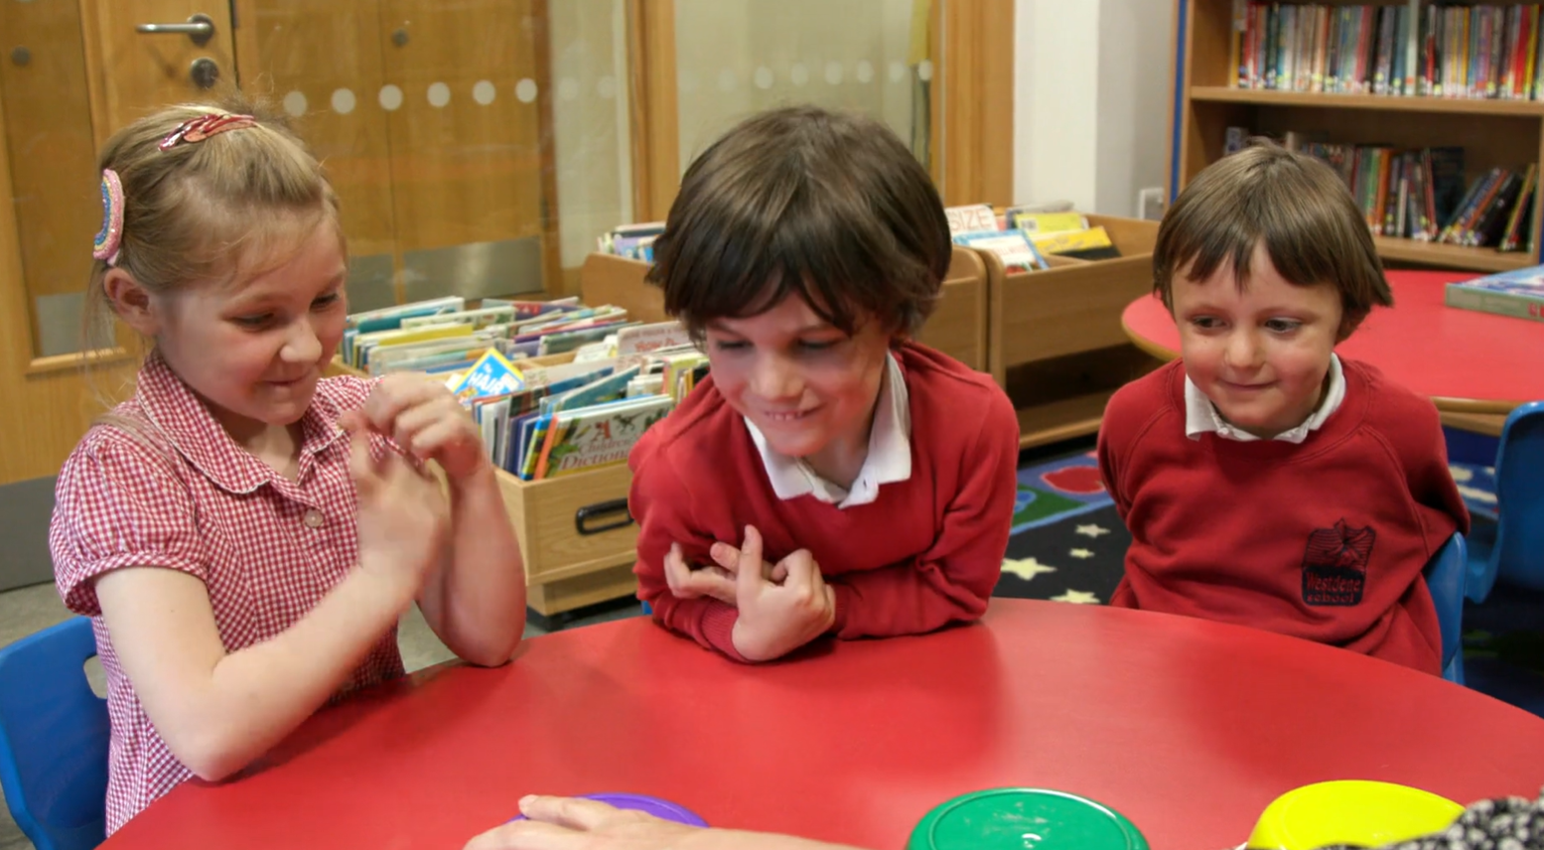
https://axis.ncetm.org.uk/mastering-number-reception-ks1-202627/videos-reception/

Slide 21
How will knowing the composition of a number help my child?
If children know that 4 can be made of 3 and 1, they can apply this knowledge later on to see that:
30 and 10 is 40
300 and 100 is 400
and that;
400 take away 100 is 300

Slide 22

Play ‘Subitising to 3 snap’
Don’t count, say the amount!
We’d like to show you some of the activities that you can do at home. These will be available on the website.
Week 1
Notes:
We will now go through some of the activities that you will be doing at home. Don’t worry about trying to remember them all as you will receive a sheet with details each week.

Slide 23
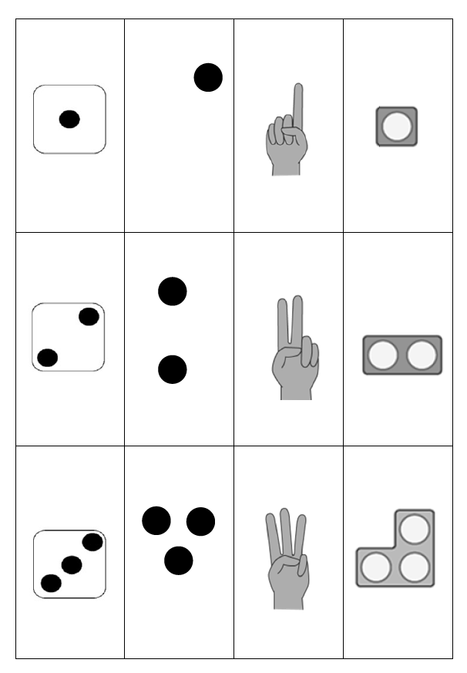
Please can you get into pairs to play a game..
Please spread the cards out and place them face-down in front of you.
Notes:
Read the instructions on the screen. Scissors should be provided for adults for this task. They will be needed again later on in the session.

Slide 24
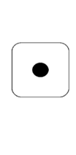

Take turns to turn two cards over and say the number you can see.
If the numbers do not match, place them back and try to remember where they are in case you need them later.

Slide 25


When it is your turn, if you turn over two cards that are the same, you can keep them.
The winner is the person with the most cards when they are all used up.
Here is 3 and here is 3. They are the same
We will give you a whole set to take away of this game .
Notes:
Can you show the number on your fingers? Mention to grown-ups that children may count to three on their fingers in Week 1, but could show you three straight away later on. Encourage children (after they have counted three) to look at their fingers, fold them down again, and then see if they can raise them again – all at the same time.
There are two ways to approach the game. If preferred, instead of having a winner, it might be better to work collaboratively to see if the grown-up/child can find all the pairs together.
It is important for the session lead (usually the class teacher) to move around the room to ensure all parents understand the task and to explain again when needed.

Slide 26

Play ‘Part-part-whole’
A ‘whole’ donut?
The ‘hole’ in the donut?
Week 1
Notes:
Be careful we don’t assume children know what we mean!
Teachers demonstrate gesture to show ‘whole’ meaning ‘all of something’.

Slide 27
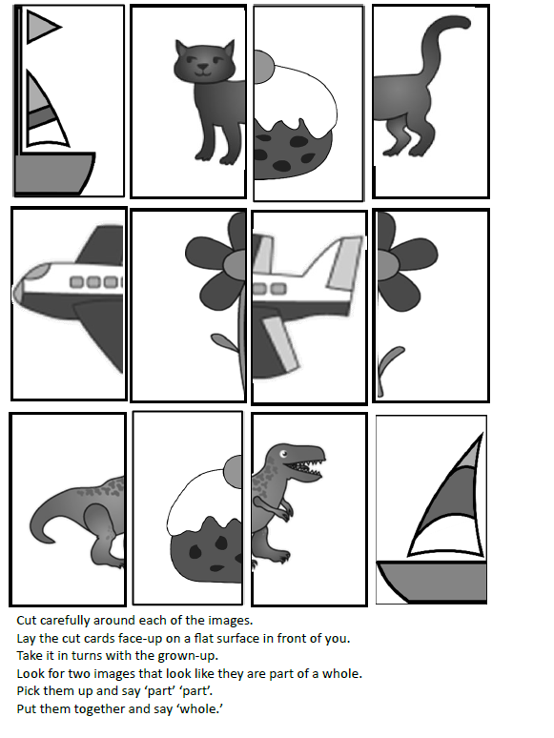
Find 2 parts that make a whole.
This game is also in the pack and on the website.
Here is how you play...
Notes:
Emphasise that these will all be in two parts.
Again the grown-ups will need to cut these into individual cards. This time, ensure the cards are placed face-up.

Slide 28

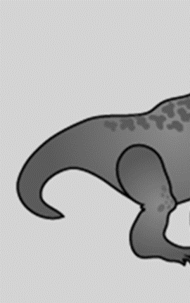
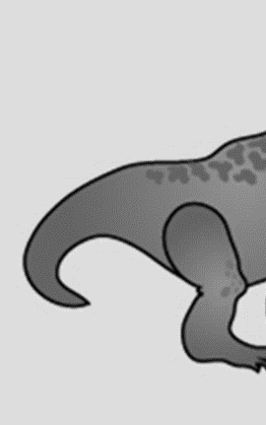

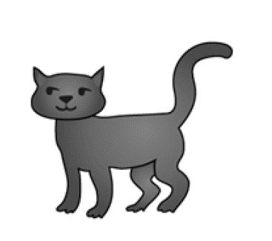

Can you see two parts that make a whole image?

Slide 29
Pick up each piece and say: ‘part… part…’
Notes:
Explain to adults that it is important for them to model the ‘part’ ‘part’ ‘whole’ talk too.

Slide 30
Now put them together and say: ‘whole!’
Can you find all the ‘wholes’ by doing the same?
This is a part, this is part, here is the whole .

Slide 31


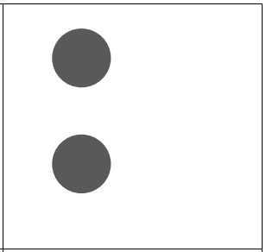
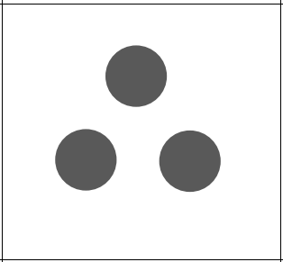

Part-part-whole with dots
Let's play!
In Week 3, you will play ‘part-part-whole’ with dots.
One person will pick up a card, and the other person must pick up the card that will ‘make 4’.
Notes:
Now we move on to seeing a set of objects as a ‘whole group’ and seeing some of the objects as ‘part of the whole’ and seeing both parts at the same time as the whole.
What we are asking children to do is really important in terms of developing their understanding of the concept of numbers being made up of other numbers.

Slide 32
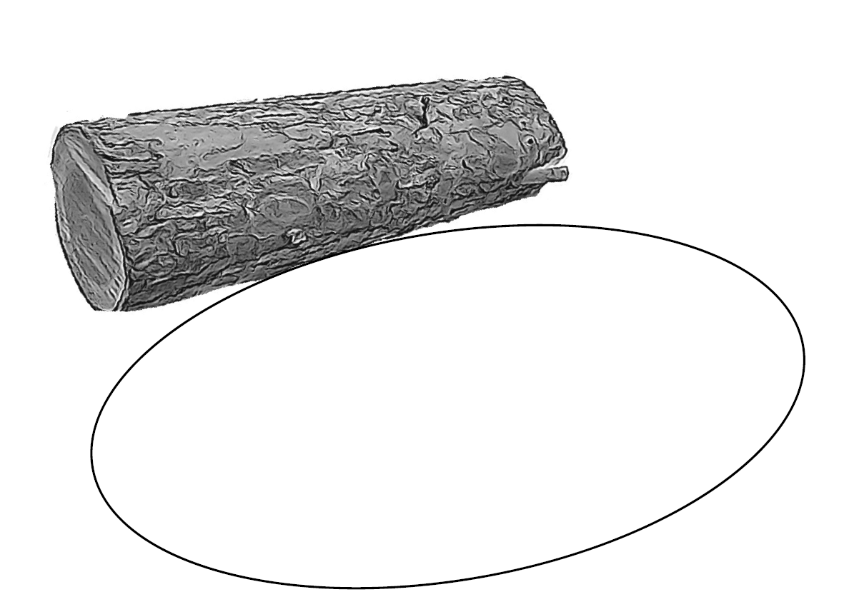
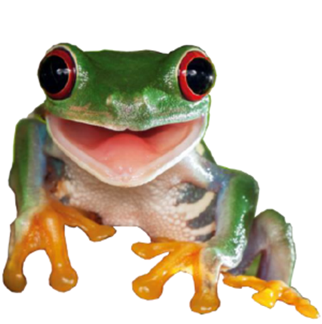
Play ‘3 frogs on a log’
The frogs on a log sheet
You will need...
3 frogs (counters)
Show frogs and log- demonstrate
Week 2
Notes:
This is an example of seeing a whole group and the parts inside it at the same time.
For the workshop example, counters should be used to represent the three frogs.
You may want to suggest that at home, children could use the back of a cereal packet to make their own frogs.

Slide 33


You will also need to show the numbers on your fingers!

Slide 34
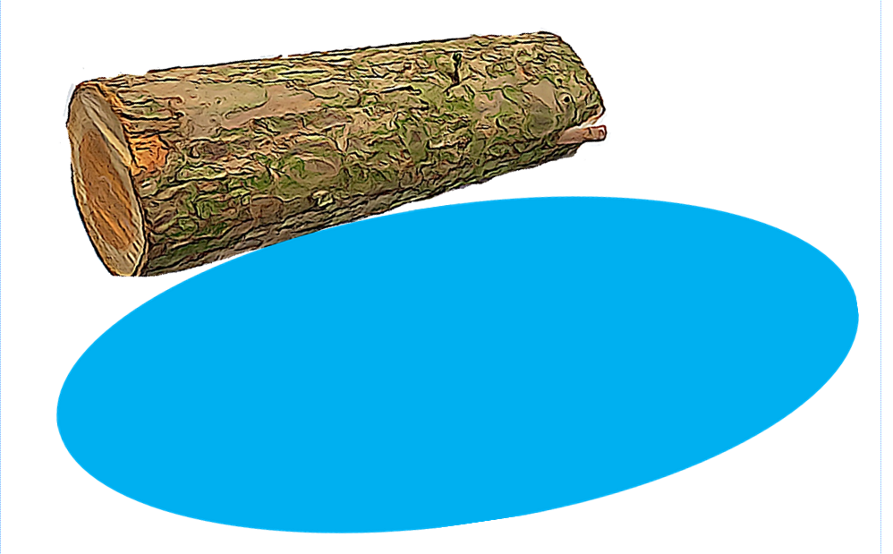
Put 3 frogs on the log
Ask your child
Show with your fingers:
How many are on the log?
How many in the pool?
How many altogether?
Notes:
The child should put three counters on their picture of the log.
Show me on one hand how many are on the log.
Show me on the other hand how many are in the pool.
The grown-ups should read from the speech bubble and watch carefully to ensure an accurate response.
Point out here that there are different ways to do it (children may show three middle fingers of one hand, or two fingers and a thumb) – that’s what deep understanding is.

Slide 35
Ask your child
Put 1 frog in the pool.
Is it still three?
Show with your fingers:
How many are on the log?
How many in the pool?
How many altogether?
Notes:
The emphasis here is on there still being three, even though they are in two sets – some on the log and some in the pool. Encourage grown-ups to gesture with their finger – How many altogether?
Children will need to put 1 finger down and 1 finger up on the other hand – this ensures that 3 are still shown (conservation of number).

Slide 36
Put another frog in the pool.
Ask your child
Is it still three?
Show with your fingers:
How many are on the log?
How many in the pool?
How many altogether?
Notes:
The emphasis here is on there still being three even though they are in two sets – some on the log and some in the pool. Parents could gesture with their finger – How many altogether?

Slide 37
Put another frog in the pool.
Ask your child
Is it still three?
Show with your fingers:
How many are on the log?
How many in the pool?
How many altogether?
Notes:
The emphasis here is on there still being three. Now we have none on the log and three in the pool, but there are still 3 altogether. Parents could gesture with their finger – How many altogether?

Slide 38
In Week 4, you will play this game again with 4 frogs… or even 5!
Notes:
The emphasis here is on there still being three. Now we have none on the log and three in the pool, but there are still 3 altogether. Parents could gesture with their finger – How many altogether?

Slide 39
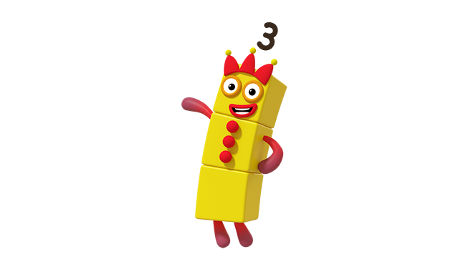
BBC iPlayer - Numberblocks - Series 1: The Whole of Me
Play ‘3 or NOT 3?’
This activity involves spotting when there are 3 of an object or explaining why there are NOT 3.
Week 2 (Image © Alphablocks)
Notes:
Perhaps highlight that mathematical talk is really important and talking about the smaller numbers will help children later on as they will feel more confident talking about numbers.

Slide 40
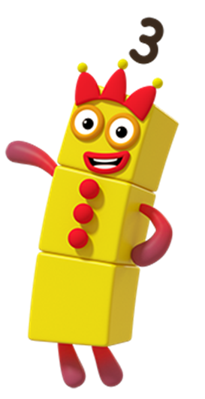
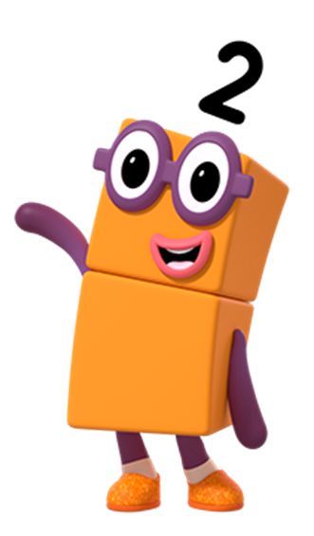


Put your thumb UP if you can see 3, and down if it is NOT 3.
(Image © Alphablocks)
Notes:
You might mention here that children could use their fingers to ‘show what they see’ on the screen. They can then say if it is three or not three by putting thumbs up or down.

Slide 41
Mastering Number 2021/22 ncetm.org.uk

Slide 42
Mastering Number 2021/22 ncetm.org.uk
Notes:
We need to emphasise here that the focus is not on telling the child (or getting the child to tell us) what the number is … Only to say that it is NOT 3.
We want to encourage verbal responses, like: ‘I know it’s not three because it needs 1 more’

Slide 43
Mastering Number 2021/22 ncetm.org.uk

Slide 44
Mastering Number 2021/22 ncetm.org.uk

Slide 45
Mastering Number 2021/22 ncetm.org.uk

Slide 46
Mastering Number 2021/22 ncetm.org.uk

Slide 47
Mastering Number 2021/22 ncetm.org.uk

Slide 48
Mastering Number 2021/22 ncetm.org.uk
Notes:
Ask again - how do you know it is NOT 3?

Slide 49
Mastering Number 2021/22 ncetm.org.uk

Slide 50
Mastering Number 2021/22 ncetm.org.uk
Notes:
Ask again - how do you know it is NOT 3?

Slide 51
Mastering Number 2021/22 ncetm.org.uk

Slide 52
Mastering Number 2021/22 ncetm.org.uk
Notes:
Ask again - how do you know it is NOT 3?

Slide 53
Mastering Number 2021/22 ncetm.org.uk

Slide 55
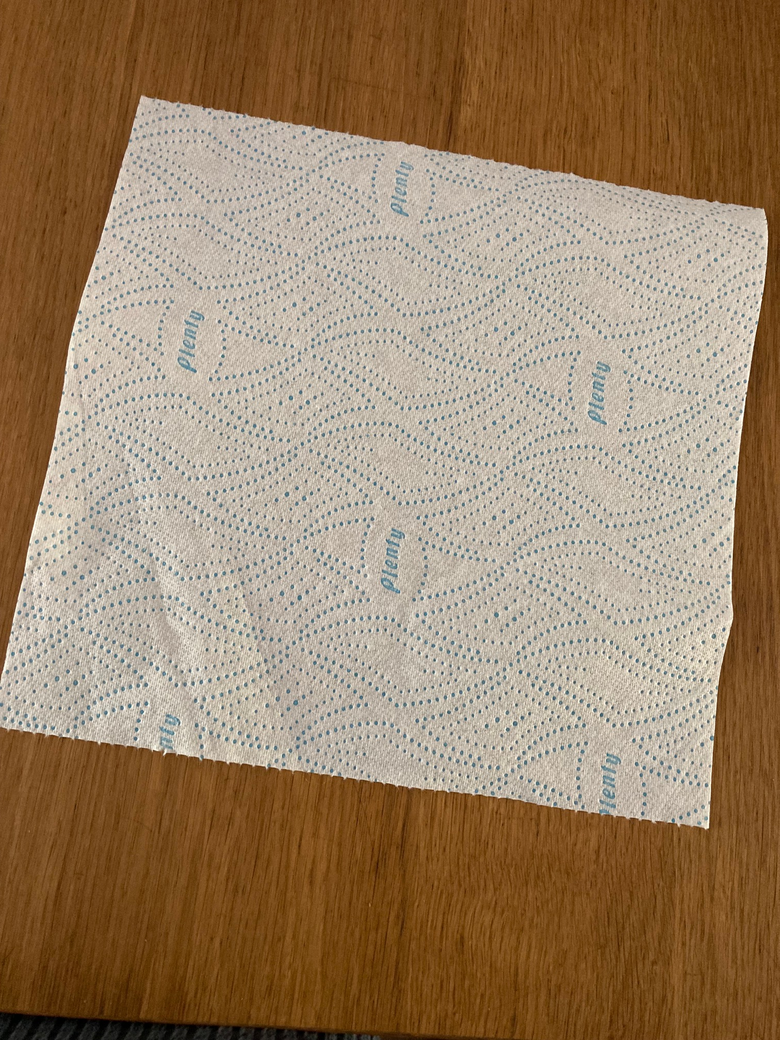
Play ‘3 or NOT 3?’ with counters
You will need 5 counters and something to cover them.
Notes:
Ensure each child has a paper towel or hand to use with their counters.

Slide 56
Grown-ups, hide some counters under the towel.

Slide 57
Reveal them quickly and ask your child…
3 or not 3?
Notes:
It is really important here to point out that we don’t want to focus on what the number IS – just whether it is 3 or NOT.
We will talk about why we know it is not 3 at the end of the game.
Children/parents will need to be reminded not to say ‘it is three’ but to say ‘it is not 3.’

Slide 58
In Week 4, you will try this with different numbers…
4 or not 4?

Slide 59
Now ask: ‘What do you need to do to make it 3?’
If I take 1 away it will make 3.
This is already 3!
I need to add 1 more to make 3.
Notes:
Now we are going to repeat the activity but we are going to ask your children to tell us what we need to do to make the number into 3. This time grown-ups will need to pause after each one and ask: What do we need to do to make it into 3?
Demonstrate these responses one at a time before allowing grown-ups to have another go with the paper towel and counters.
These are typical examples of what we might want children to say to reason about how to make 3.
It would be useful for parents to model this language and promote these responses from pupils, but parents may need some support to help them to model this.
This time, parents should hide one, two or three objects under the paper towel and ask, ‘What do we need to do to make it into 3?’ Leave the responses on the screen for reference.

Slide 60
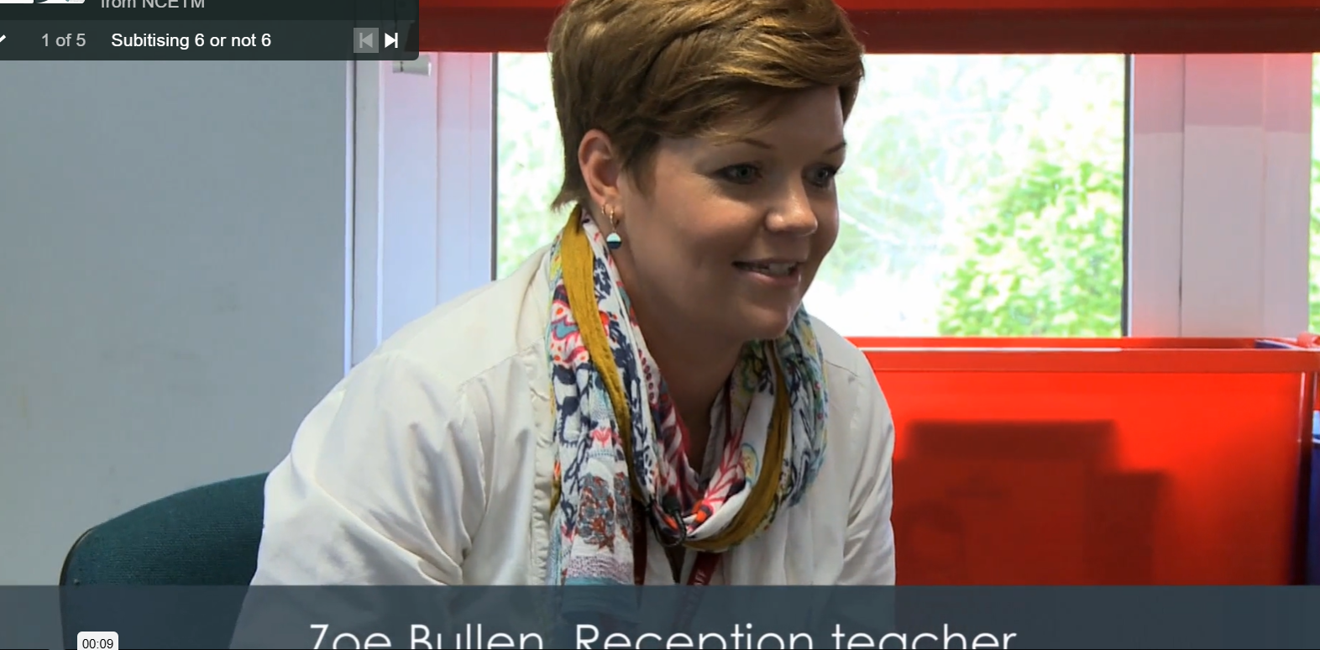
https://axis.ncetm.org.uk/mastering-number-reception-ks1-202627/videos-reception/

Slide 61
Home Learning
You are going to take all the games we made today home with you.
This home learning is on our website on the EYFS page.
You should repeat the games many times to secure the learning.
Notes:
We anticipate each day that you will spend about ten minutes on the activity. Sometimes it may not take 10 minutes which is fine – maybe you could try some of the additional activities too on those days.

Slide 62
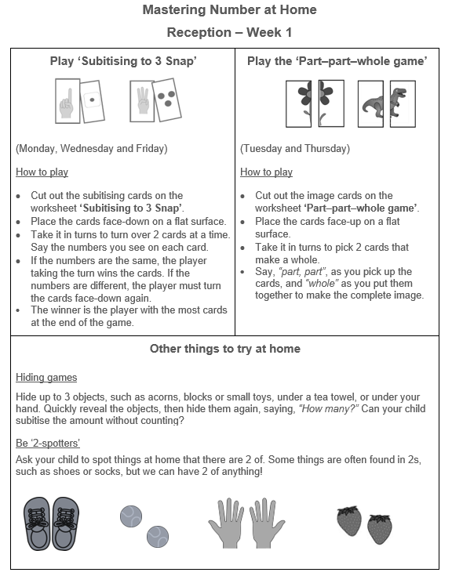
Notes:
Ensure parents have the first sheet in the pack on the day of the workshop so they can see the layout and ask any questions.
1st Click: Shows the game we played with the subitising to 3 cards. The home learning sheet and diary asks you to play this on Monday, Wednesday and Friday. Try to keep to this if possible, but if you have to move days around due to other commitments, that is fine.
2nd Click: This shows the part-part-whole game that we played. The sheet asks you to play this on Tuesday and Friday.
3rd Click: This section shows some other things that you might like to try at home. It is not essential to do all of these, but they will support your child in their learning if you can fit any of them in.
Where possible, we would like the families to stick to the order of the homework exercises. The additional activities are optional. The might be attempted on the same day, or at the weekend, depending on time.
Some children have clubs during the week and will miss homework. We ask them to try to fit a 10 minute session in at the weekend instead.

Slide 63
Thank you!
Below is a link to a useful video about Mastering Number.
youtube.com/watch?v=QnElt_L92FA&t=1s
Notes:
Ask if there are any questions. Parents can fill out the evaluation sheet for the session.

