Slide 1

St Paul's C of E Primary School
KS1 Maths Parents Meeting

Slide 2
The 2014 National Curriculum for Maths aims to ensure that all children:
Become fluent in the fundamentals of Mathematics
Are able to reason mathematically
Can solve problems by applying their Mathematics

Slide 3
At St Paul’s we also aim to ensure that all children:
Enjoy maths
Experience success
Become confident in their ability to use and apply their mathematical skills and knowledge in a range of contexts
Recognise the importance and relevance of Maths in the wider world
Develop mathematical resilience

Slide 4
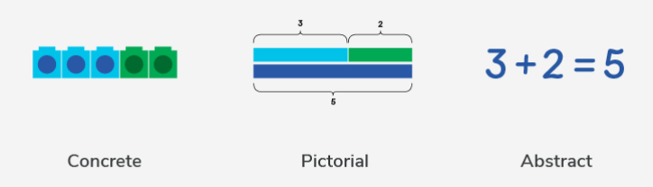
Children learn new concepts through the concrete, pictorial, abstract approach.
In all year groups, reinforcement is achieved by going back and forth between these representations.

Slide 5
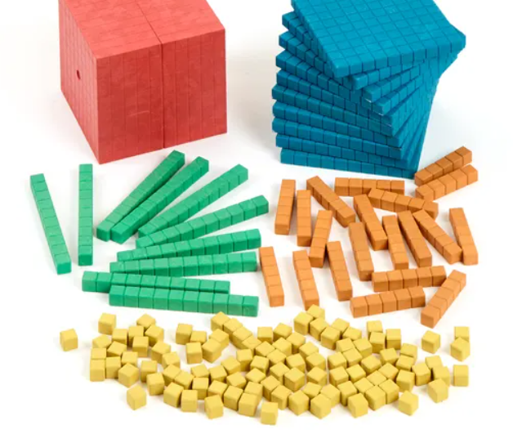
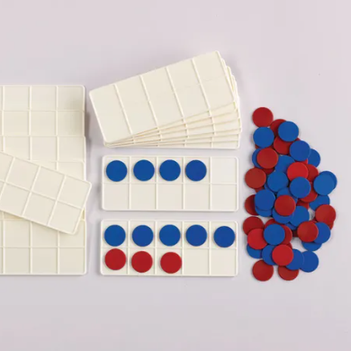
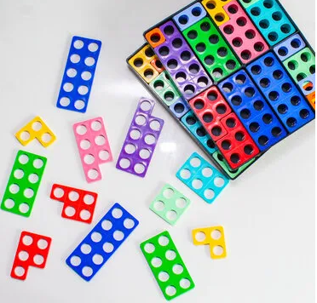
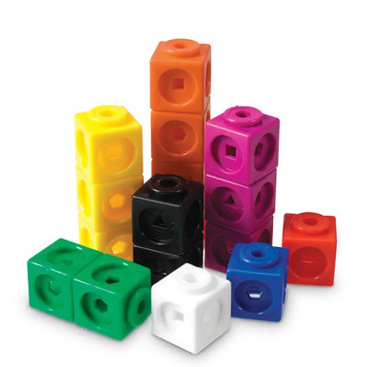

Concrete Representation
A pupil is first introduced to an idea or a skill by acting it out with real objects (manipulatives).
This is a 'hands on' component using real objects and it is the foundation for conceptual understanding.

Slide 6
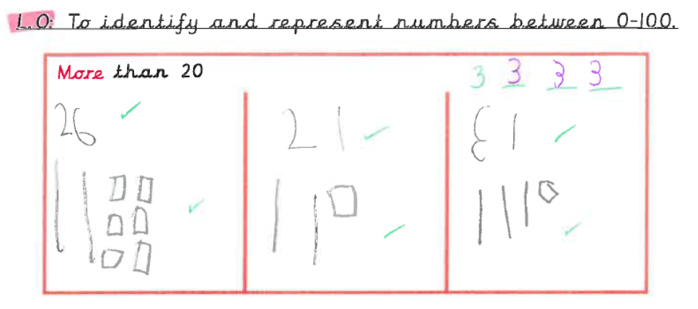
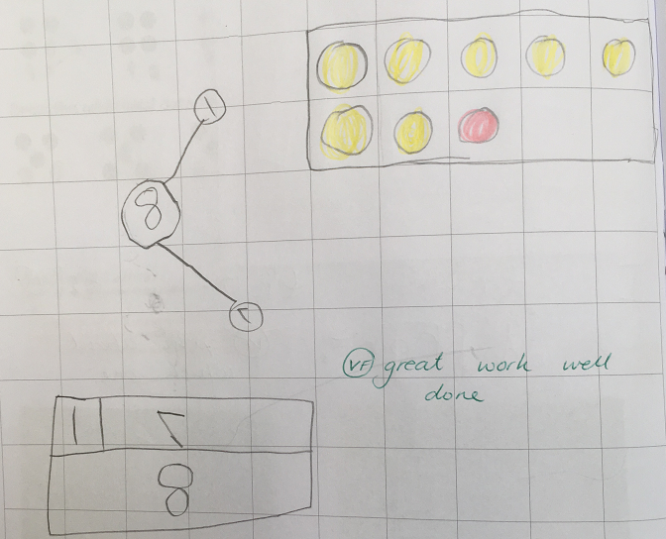
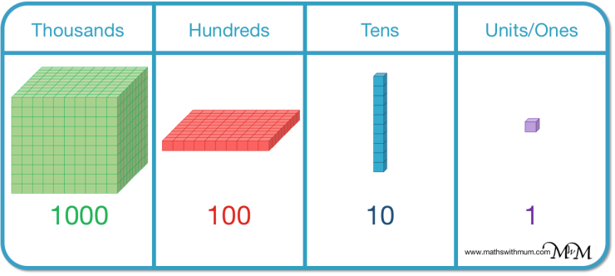
Pictorial Representation
A pupil has sufficiently understood the hands-on experiences performed and can now relate them to representations, such as a diagram or picture of the problem.

Slide 7
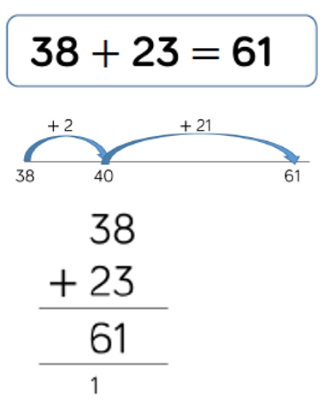
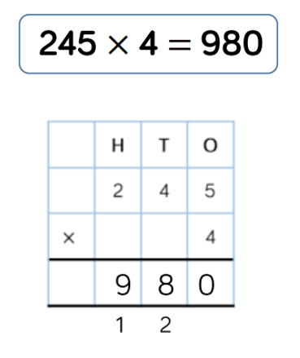
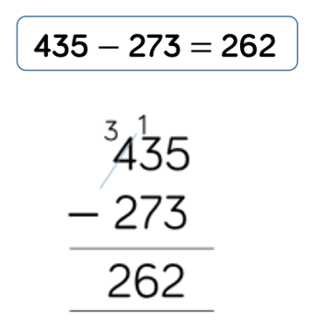
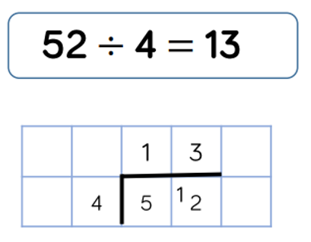
Abstract Representation
A pupil is now capable of representing problems by using numbers and mathematical notation.
162
162

Slide 8
Teaching Maths at St Paul's
At St Paul's maths is taught for 1 hour everyday. We use a scheme called White Rose. This follows the concrete, pictorial abstract approach and incorporates problem solving and reasoning questions.
During each lesson the children are taught the concept as a whole class. Some children will have support from a Teaching Assistant during this time. Children then go on to complete an independent task. Again, some children will have support to complete these.

Slide 9
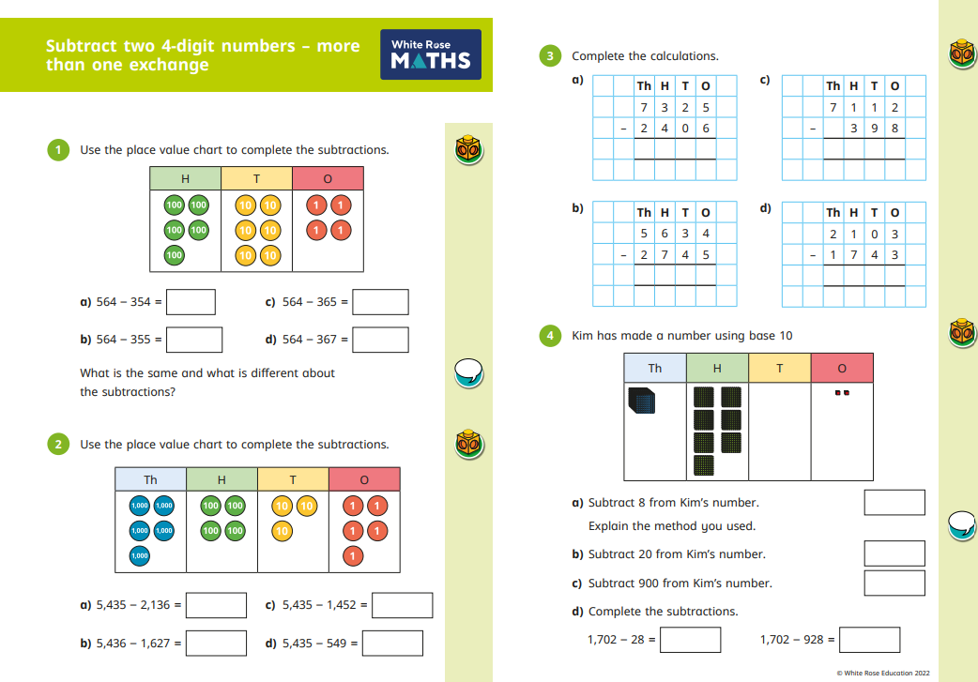

Slide 10
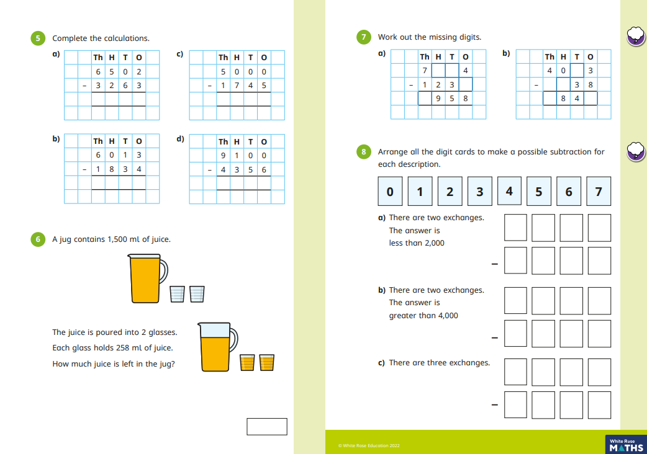

Slide 11
Fluency
In addition to daily maths lessons, all children also have maths fluency sessions 4 times per week. We use the NCETM Mastering Number to deliver fluency. These sessions last about 20 minutes and build efficiency, accuracy and flexibility.
Why Does Fluency Matters?
Reduces Cognitive Load: When basic facts (like number bonds or times tables) and standard procedures can be retrieved quickly and automatically, it frees up working memory.
Supports Deep Thinking: By lifting the burden on working memory, students can channel their mental capacity into higher-order reasoning, strategic thinking, and tackling complex problem-solving tasks.
Builds Confidence: Familiarity with mathematical structures helps lower anxiety and empowers learners to handle new concepts with a sense of assurance.

Slide 12
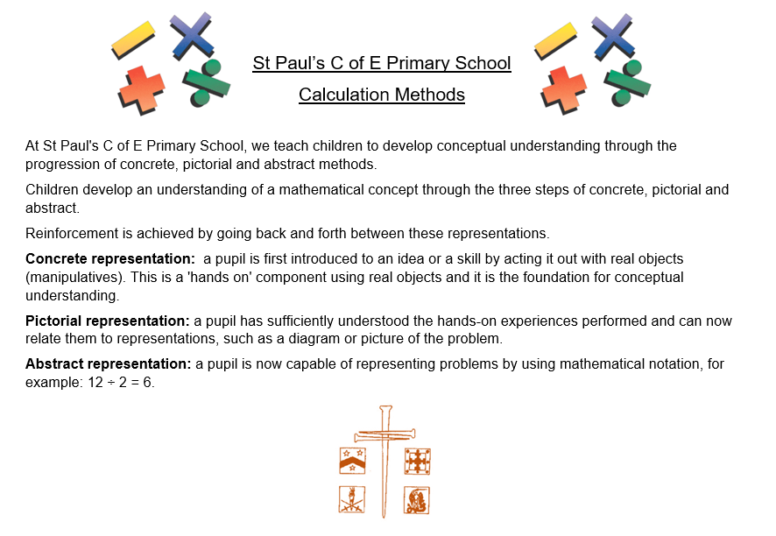
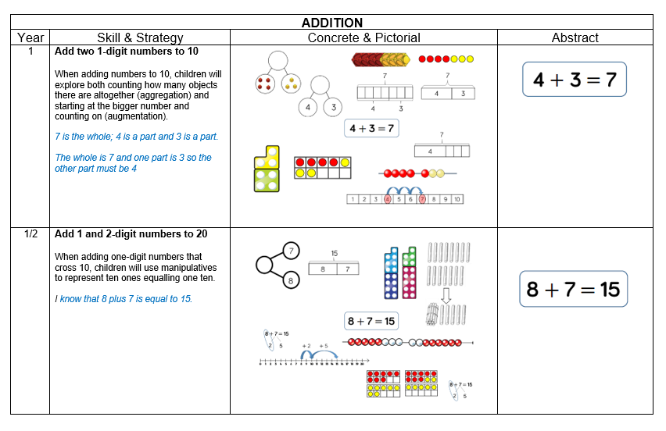
Link to St Paul's C of E Calculation Methods
https://www.saintpaulsschool.org.uk/calculations-methods/

Slide 13
What can you do at home to support your child’s learning?
FLUENCY
Key Instant Recall Facts (KIRFs)
Instant recall of facts helps enormously with mental agility in mathematics; when children move onto written calculations and abstract methods, knowing these key facts is crucial.
For children to develop rapid recall of these facts, they need to be practised frequently and in short bursts.
Each year group has been allocated six key facts to focus on throughout the year.

Slide 14
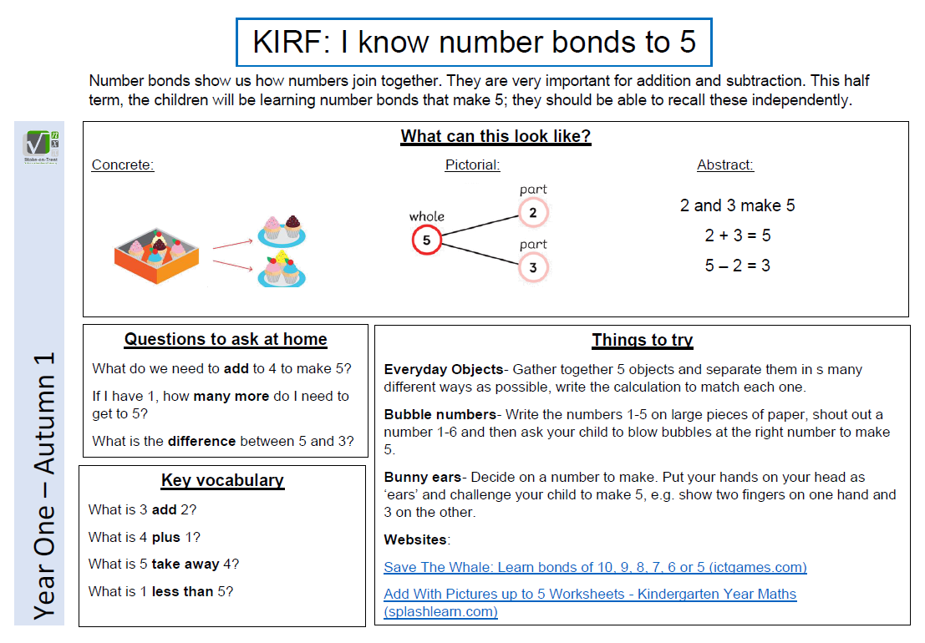
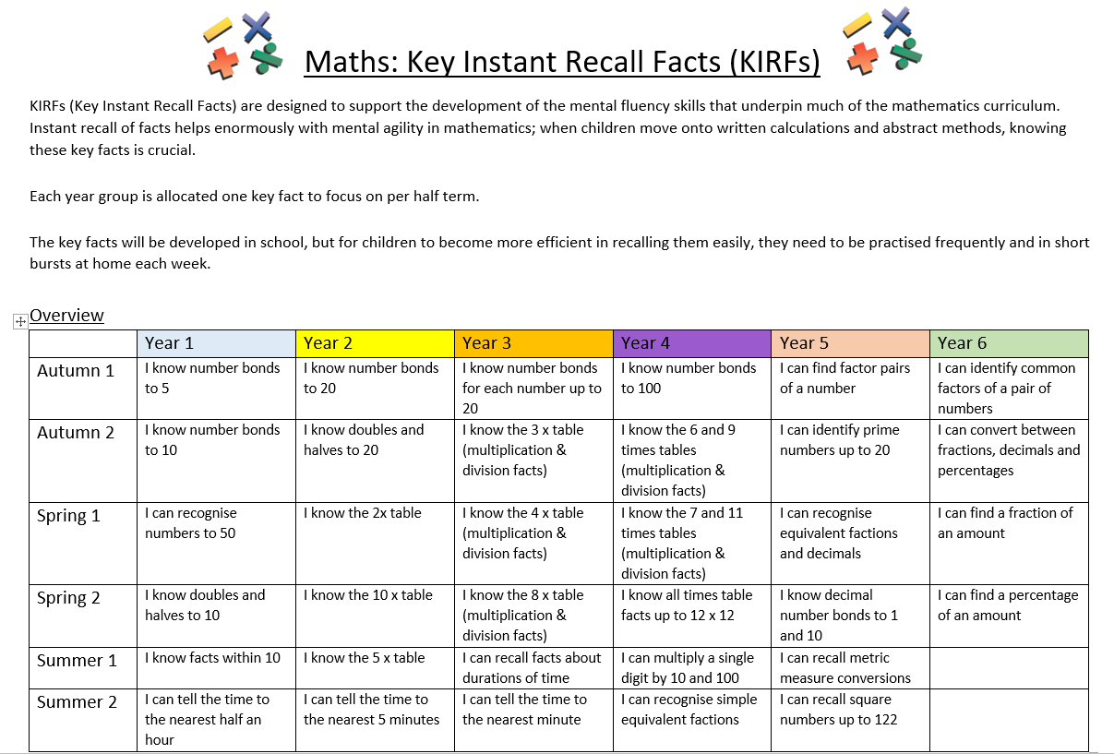
Link to half termly year group KIRFs on school website: https://stpaulswarwick.secure-primarysite.net/key-instant-recall-facts/

Slide 15
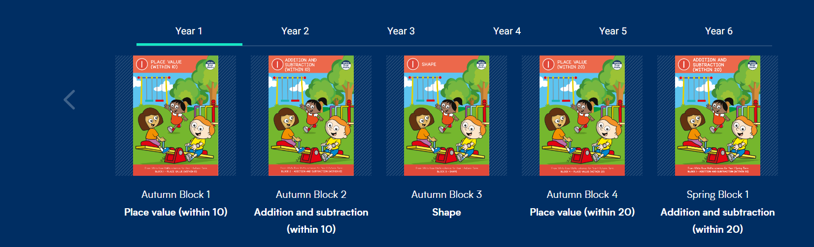
We follow the White Rose Maths scheme of learning, which promotes a mastery approach to maths.
Link to parent resources:
https://whiterosemaths.com/parent-resources
Link to One Minute Maths app:
https://whiteroseeducation.com/1-minute-maths#download

Slide 16
Maths Home Learning at St Paul's C of E Primary School.
Home Learning for maths differs depending on the Key Stage of your child.
In Key Stage One, we have prioritised the learning of Key Instant Recall Facts (KIRFs).
Look on your child's class page for the one for this term. If you want to look ahead or look back, the rest can be accessed here.
https://stpaulswarwick.secure-primarysite.net/key-instant-recall-facts/

Slide 17
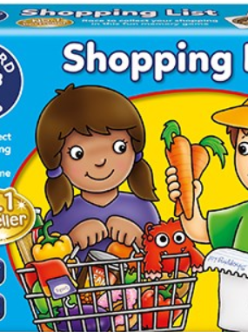

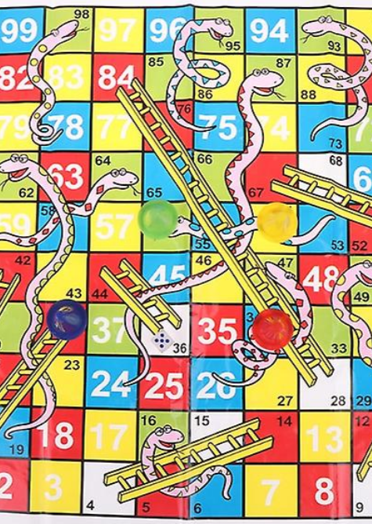
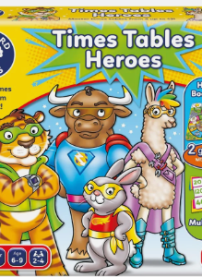

In addition to this, please play lots of number and counting games such as Snakes and Ladders with your child as well as any games using dice.

Slide 18
Recommended Online Maths Games
There are loads of great ones available for free. Here are just a few. They range from simple counting games to times table games.
https://www.topmarks.co.uk/learning-to-count/underwater-counting
https://www.topmarks.co.uk/learning-to-count/place-value-basketball
https://www.topmarks.co.uk/maths-games/hit-the-button
http://www.math-play.com/Place-Value-Millionaire/place-value-millionaire-game_html5.html

Slide 19
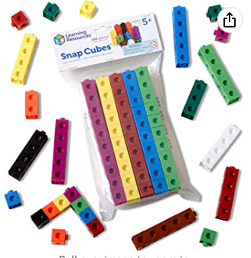
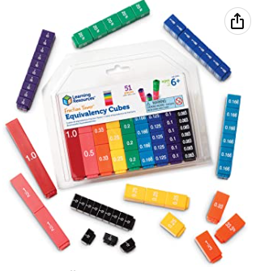
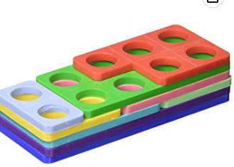
Suggested resources to support your child at home.
https://www.amazon.co.uk/Learning-Resources-Snap-Cubes-Set/dp/B000G3LR9Y/ref=sr_1_12?crid=77IR7A02BHTO&keywords=learning+resources+maths+link+cubes&qid=1672914078&s=kids&sprefix=learning+resources+maths+link+cubes%2Ctoys%2C89&sr=1-12
https://www.amazon.co.uk/Numicon-Bag-Shapes-1-10/dp/0198487312/ref=d_pd_sbs_sccl_3_4/262-3769056-4008113?pd_rd_w=GuldB&content-id=amzn1.sym.ea6fa2b9-b25b-401b-aef1-8543b649508d&pf_rd_p=ea6fa2b9-b25b-401b-aef1-8543b649508d&pf_rd_r=M3B45GXJEJGVHCBDPQD1&pd_rd_wg=Q2U1C&pd_rd_r=28dcbbf1-1508-4621-bd92-7e06b772c6b6&pd_rd_i=0198487312&psc=1
https://www.amazon.co.uk/Learning-Resources-LSP2509-UKM-Fraction-Equivalency/dp/B000296LSO/ref=sr_1_4_mod_primary_new?crid=1WBCALVCE44T3&keywords=learning%2Bresources%2Bfraction%2Btowers&qid=1672914315&s=kids&sbo=RZvfv%2F%2FHxDF%2BO5021pAnSA%3D%3D&sprefix=learning%2Bresources%2Bfraction%2Btowers%2Ctoys%2C161&sr=1-4&th=1

Slide 20


