Slide 1

St Paul's C of E Primary School
KS 2 Maths Parents Meeting

Slide 2
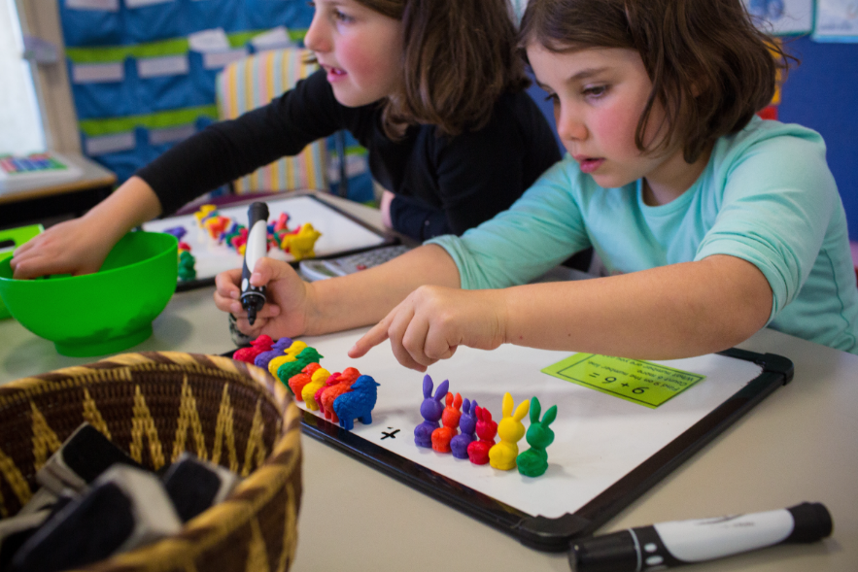
At St Paul’s we aim to ensure that all children:
Enjoy maths
Experience success
Become confident in their ability to apply their mathematical skills in a range of contexts
Recognise the importance and relevance of Maths in the wider world
Develop mathematical resilience

Slide 3
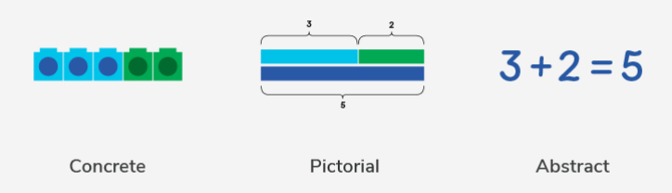
Children learn new concepts through the concrete, pictorial, abstract approach.
Reinforcement is achieved by going back and forth between these representations.

Slide 4
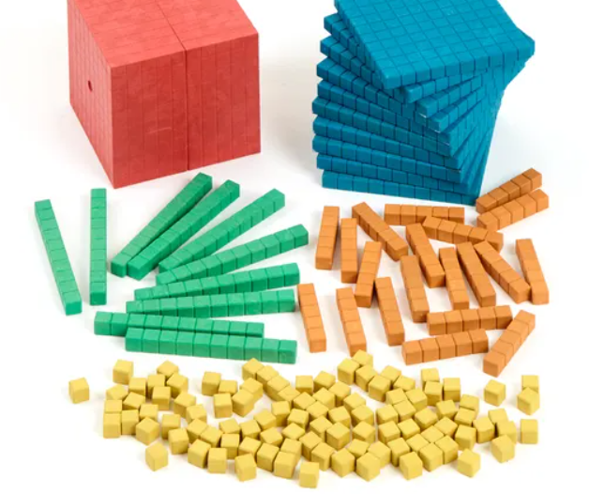
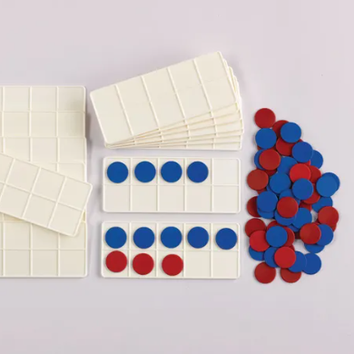
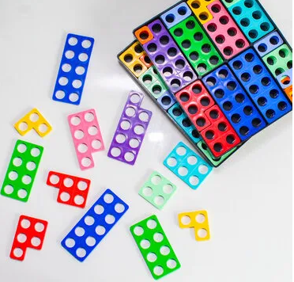
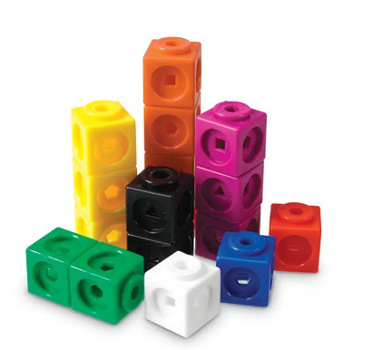

Concrete Representation
A pupil is first introduced to an idea or a skill by acting it out with real objects (manipulatives).
This is a 'hands on' component using real objects and it is the foundation for conceptual understanding.

Slide 5
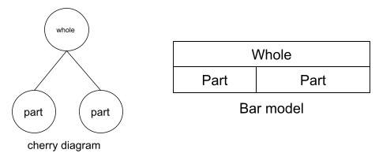
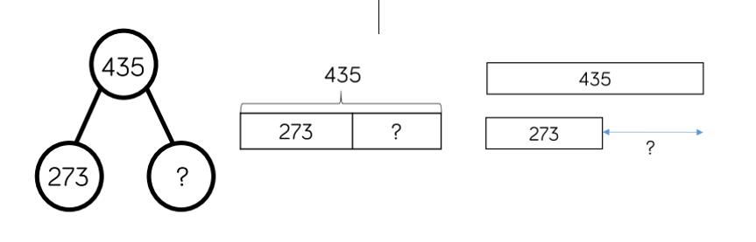
Pictorial Representation
A pupil has sufficiently understood the hands-on experiences performed and can now relate them to representations, such as a diagram or picture of the problem.
435 – 273 = ?

Slide 6
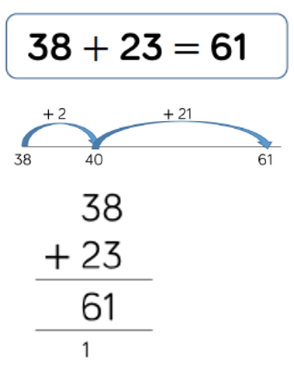
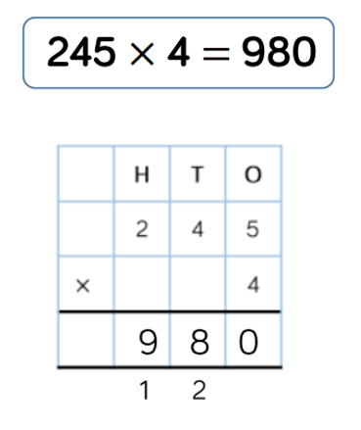
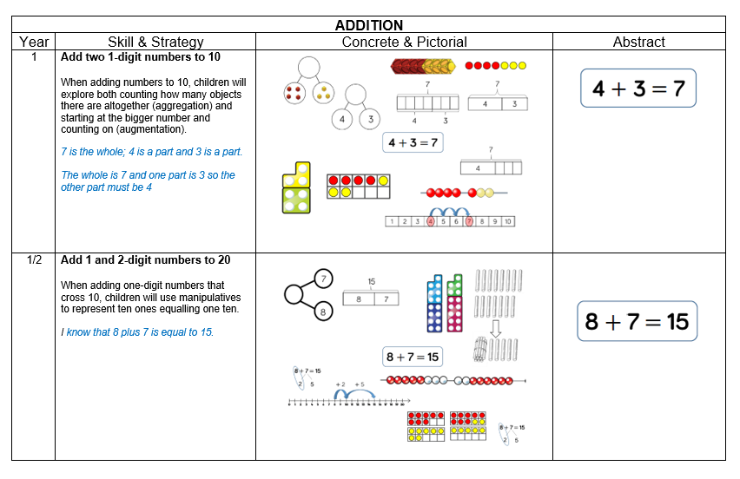
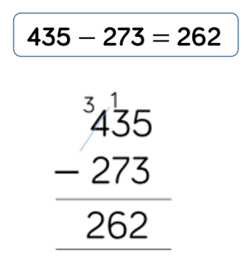
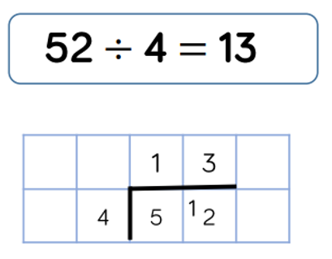
Abstract Representation
Pupils are now capable of representing problems by using numbers and mathematical notation.
Link to St Paul's C of E Calculation Methods:
https://www.saintpaulsschool.org.uk/calculations-methods/
162
162

Slide 7
Teaching Maths at St Paul's
At St Paul's maths is taught for 1 hour everyday. We use a scheme called White Rose. This follows the concrete, pictorial abstract approach and incorporates problem solving and reasoning questions.
During each lesson the children are taught the concept as a whole class. Some children will have support from a Teaching Assistant during this time. Children then go on to complete an independent task. Again, some children will have support to complete these.

Slide 8
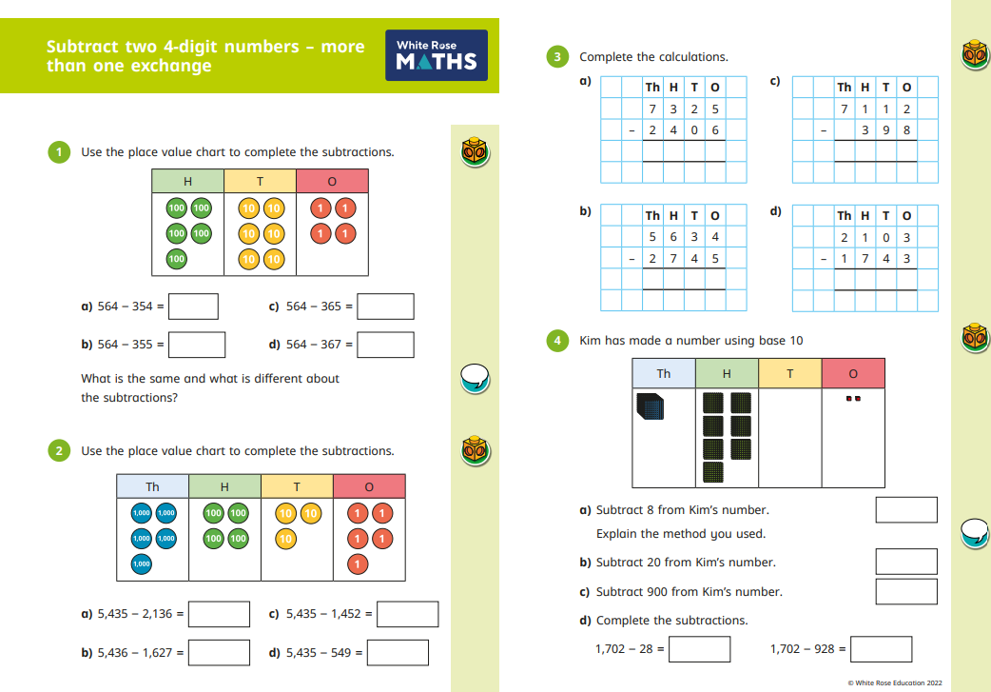

Slide 9
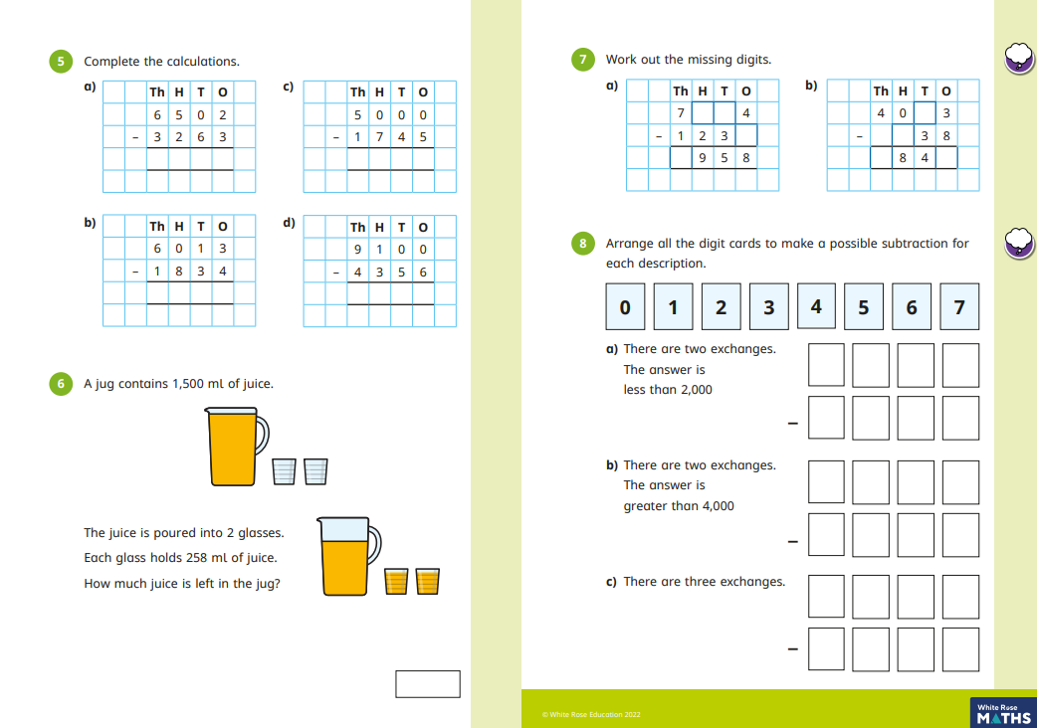

Slide 10

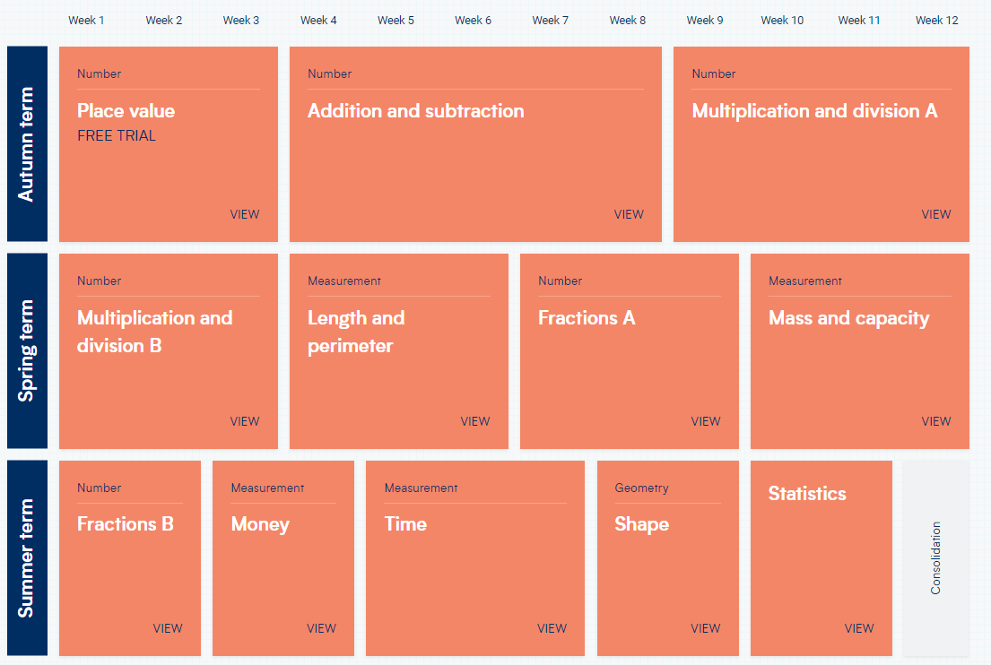
Topics are broken up into units of learning and then further broken up into small steps (lessons).
Link to yearly overview of topics for each year group:
https://whiteroseeducation.com/resources?year=year-1-new&subject=maths

Slide 11
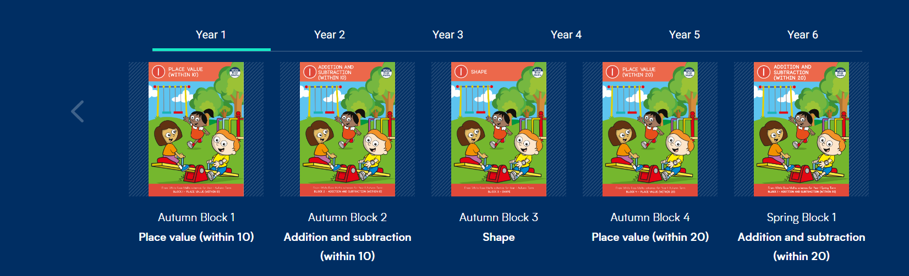
We follow the White Rose Maths scheme of learning, which promotes a mastery approach to maths.
Link to parent resources:
https://whiterosemaths.com/parent-resources
Link to One Minute Maths app:
https://whiteroseeducation.com/1-minute-maths#download

Slide 12
Fluency
In addition to daily maths lessons, all children also have maths fluency sessions 4 times per week. We use the NCETM Mastering Number to deliver fluency. These sessions last about 20 minutes and build efficiency, accuracy and flexibility.
Why Does Fluency Matters?
Reduces Cognitive Load: When basic facts (like number bonds or times tables) and standard procedures can be retrieved quickly and automatically, it frees up working memory.
Supports Deep Thinking: By lifting the burden on working memory, students can channel their mental capacity into higher-order reasoning, strategic thinking, and tackling complex problem-solving tasks.
Builds Confidence: Familiarity with mathematical structures helps lower anxiety and empowers learners to handle new concepts with a sense of assurance.

Slide 13
What can you do at home to support your child’s learning?
FLUENCY
Key Instant Recall Facts (KIRFs)
Instant recall of facts helps enormously with mental agility in mathematics; when children move onto written calculations and abstract methods, knowing these key facts is crucial.
For children to develop rapid recall of these facts, they need to be practised frequently and in short bursts.
Each year group has been allocated six key facts to focus on throughout the year.

Slide 14
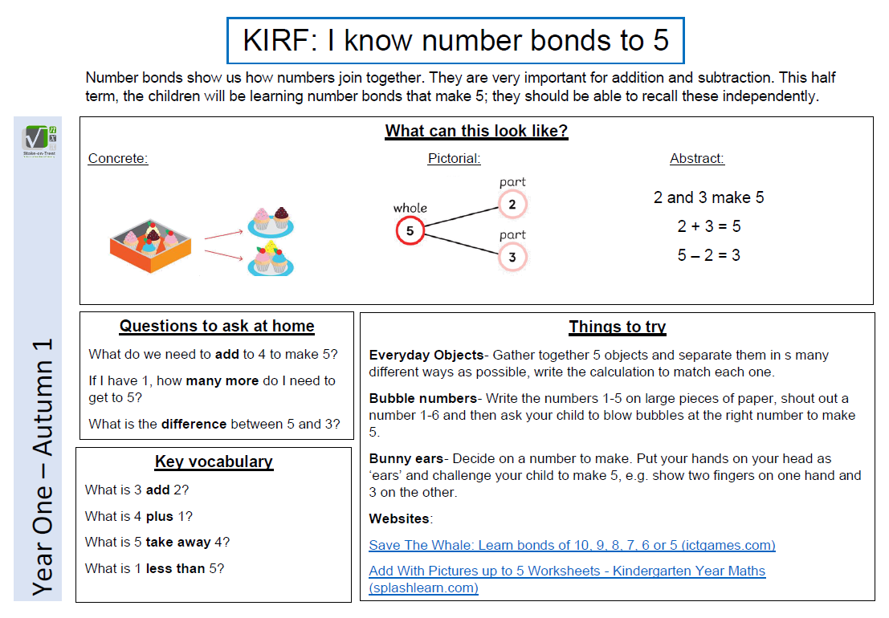
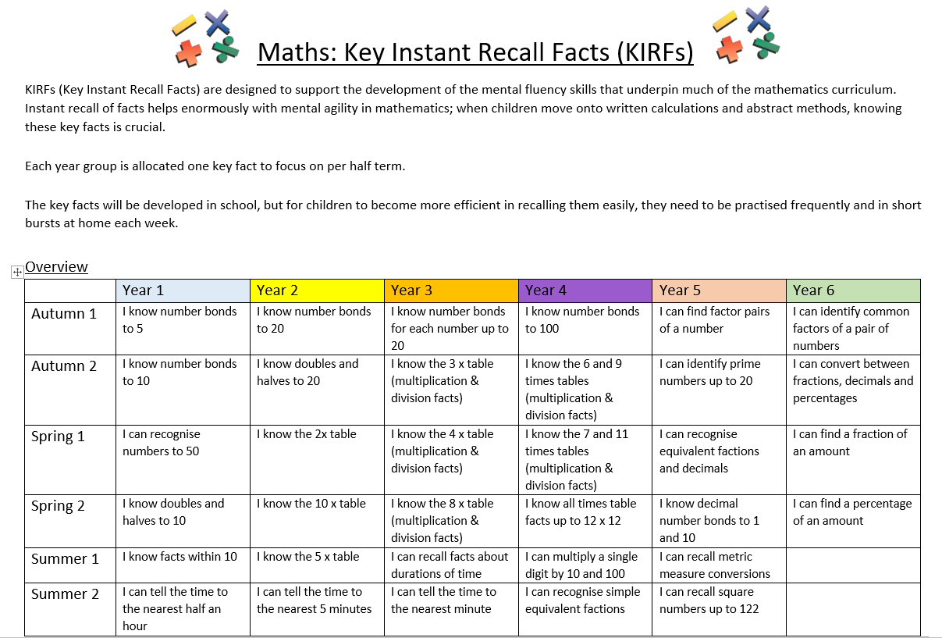
Link to half termly year group KIRFs on school website: https://stpaulswarwick.secure-primarysite.net/key-instant-recall-facts/

Slide 15
Maths Home Learning at St Paul's C of E Primary School.
Year 3 and 4- Children will be set a short piece of maths homework (along with their spellings) each week to be completed in their Home Learning books.
Tasks will be set on a Friday and there will be an expectation that they are handed back in on Wednesday.
Year 5 and 6- Children will be assigned a short piece of paper-based maths learning that will be sent home in a homework folder.
Tasks will be set on a Wednesday and there will be an expectation that they are completed by the following Tuesday.

Slide 16
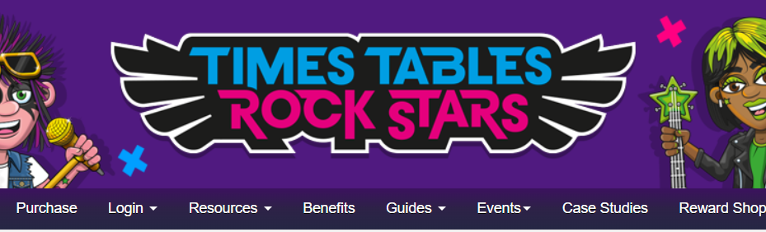
Maths Home Learning at St Paul's C of E Primary School.
Children will be given a login to Times Table Rock Stars.
Years 3-6: Encourage children to use at least 3x per week to promote their rapid recall of times table facts.
https://ttrockstars.com/

Slide 17
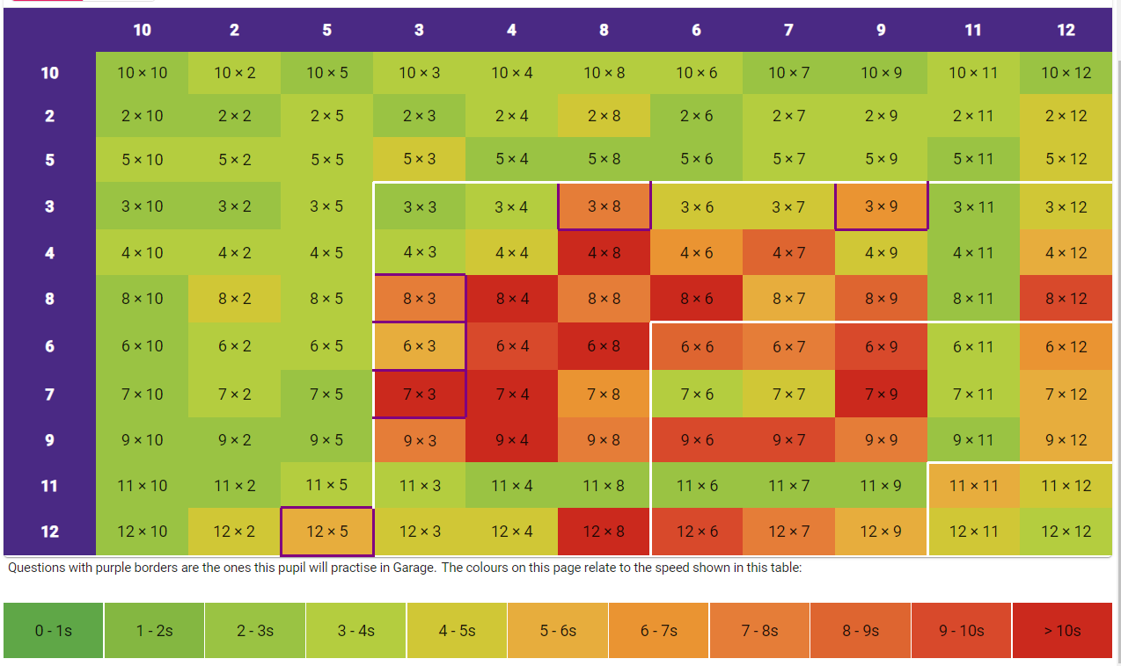
Times table fluency – heat map

Slide 18
Link to half termly year group KIRFs on school website: https://stpaulswarwick.secure-primarysite.net/key-instant-recall-facts/
How can you help your child develop mental fluency?

Slide 19
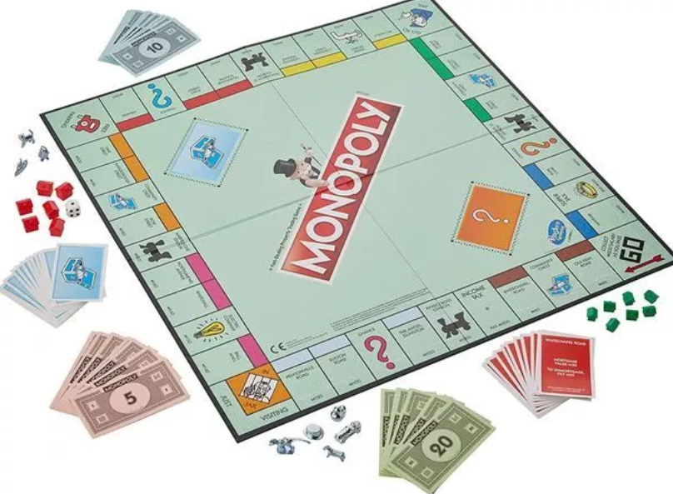
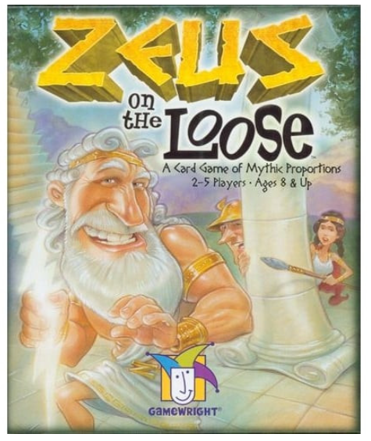
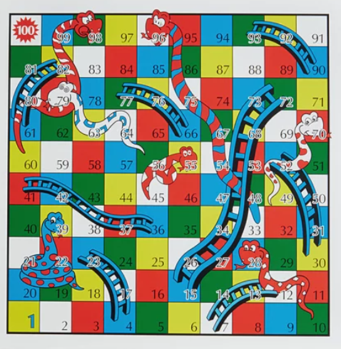
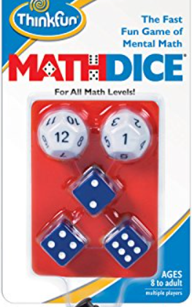
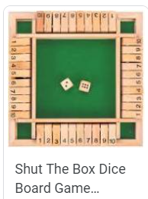

Play board games!

Slide 20
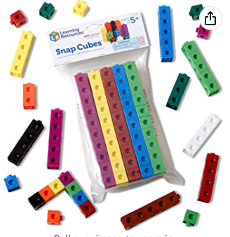
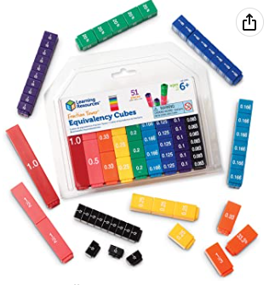
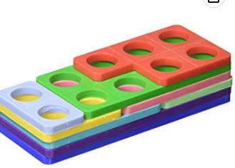
Suggested resources to support your child at home.
https://www.amazon.co.uk/Learning-Resources-Snap-Cubes-Set/dp/B000G3LR9Y/ref=sr_1_12?crid=77IR7A02BHTO&keywords=learning+resources+maths+link+cubes&qid=1672914078&s=kids&sprefix=learning+resources+maths+link+cubes%2Ctoys%2C89&sr=1-12
https://www.amazon.co.uk/Numicon-Bag-Shapes-1-10/dp/0198487312/ref=d_pd_sbs_sccl_3_4/262-3769056-4008113?pd_rd_w=GuldB&content-id=amzn1.sym.ea6fa2b9-b25b-401b-aef1-8543b649508d&pf_rd_p=ea6fa2b9-b25b-401b-aef1-8543b649508d&pf_rd_r=M3B45GXJEJGVHCBDPQD1&pd_rd_wg=Q2U1C&pd_rd_r=28dcbbf1-1508-4621-bd92-7e06b772c6b6&pd_rd_i=0198487312&psc=1
https://www.amazon.co.uk/Learning-Resources-LSP2509-UKM-Fraction-Equivalency/dp/B000296LSO/ref=sr_1_4_mod_primary_new?crid=1WBCALVCE44T3&keywords=learning%2Bresources%2Bfraction%2Btowers&qid=1672914315&s=kids&sbo=RZvfv%2F%2FHxDF%2BO5021pAnSA%3D%3D&sprefix=learning%2Bresources%2Bfraction%2Btowers%2Ctoys%2C161&sr=1-4&th=1

Slide 21


